Slide 1
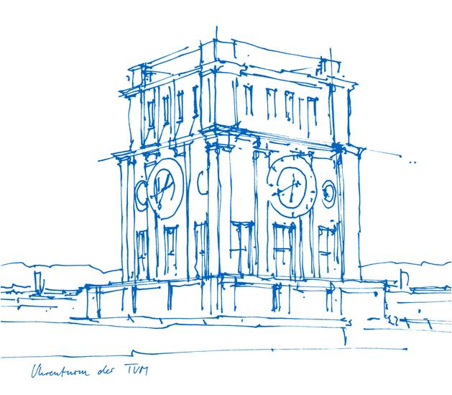
A Pipeline for Extracting Simple Rules from Medical Literature
for Automatic Disease Detection in Histopathology
Master‘s Thesis in Informatics
Emirhan Nadir Karaman
Technische Universität München
School of Computation, Information and Technology
Chair of Connected Mobility
Supervisor: Frederic Mrozinski, M.Sc.
Examiner: apl. Prof. Dr. Georg Groh
Munich, 11. August 2026
Notes:
Good morning. I'm Emirhan Karaman; this is my Master's thesis, supervised by Frederic
Mrozinski and examined by Professor Groh.
The title splits in two. Input: histopathology papers. Output: small, typed, subject-outcome rules
a pathologist could CHECK. That word does the work — everything follows from taking it seriously.
[0:20] -> "Let me start with why that's hard."

Slide 2
Diagnostic knowledge is trapped in prose, and an LLM's word for it is not enough
Motivation and research gap
• Facts live in text: biomarker expression, morphology, prognostic direction
• LLMs can read at scale; but they hallucinate, omit qualifiers, and paraphrase
• A claim you cannot trace back to a source is not usable
• Components are mature in isolation; the audited end-to-end system is not
Auditability is a hard requirement, not a feature added afterwards
Notes:
Histopathology diagnosis rests on facts that live in prose — which biomarker in which
subtype, which morphology supports which diagnosis, better or worse prognosis. Those facts exist,
scattered across thousands of papers no pathologist can read.
Language models can. But their failure modes are exactly the ones that matter here: they invent
plausible claims, drop the qualifier that made a claim true, and paraphrase until you cannot find
the original sentence. Clinically, a claim you cannot verify is not a weak result — it is not a
result.
So the requirement is traceability. The gap: layout parsing, entity linking, entailment checking,
cost-aware cascading are each mature alone. Combining them into one auditable system, evaluated
under a joint cost AND quality constraint, is rare.
[0:50] -> "I turned that into five questions, each with a number attached."

Slide 3
Five research questions, each answered by a measurement
RQ1: Document extraction. How faithfully are text, tables, figures and captions recovered, and how much does the pipeline add over an off-the-shelf baseline?
RQ2: Knowledge extraction & provenance. What is the quality of the extracted findings and rules, and is provenance preserved end-to-end?
RQ3: Cost–quality trade-off. Is the agreement-based cascade worth its cost against a single strong model?
RQ4: Grounding & relation classification. How does one shared biomedical NLI model perform in both roles?
RQ5: Held-out generalization. Does a configuration calibrated on one set of papers transfer, or does it overfit?
RQ2–RQ5 are measured against LLM-generated silver labels: agreement with the labeler, not with ground truth
Notes:
RQ1 is the document layer — and how much of the gain is mine rather than the
off-the-shelf tool. RQ2 is provenance. RQ3 is cost, and where the interesting result lives. RQ4
asks whether one frozen NLI model does two jobs. RQ5 asks whether the calibration overfits.
One caveat up front, because it conditions everything after RQ1: the reference labels for RQ2–RQ5
came from Claude Opus, not a human expert. Those scores measure AGREEMENT WITH THE LABELLER. RQ1
is the exception — human labels, written rubric.
[0:40] -> "Here is the system those questions ask about."

Slide 4
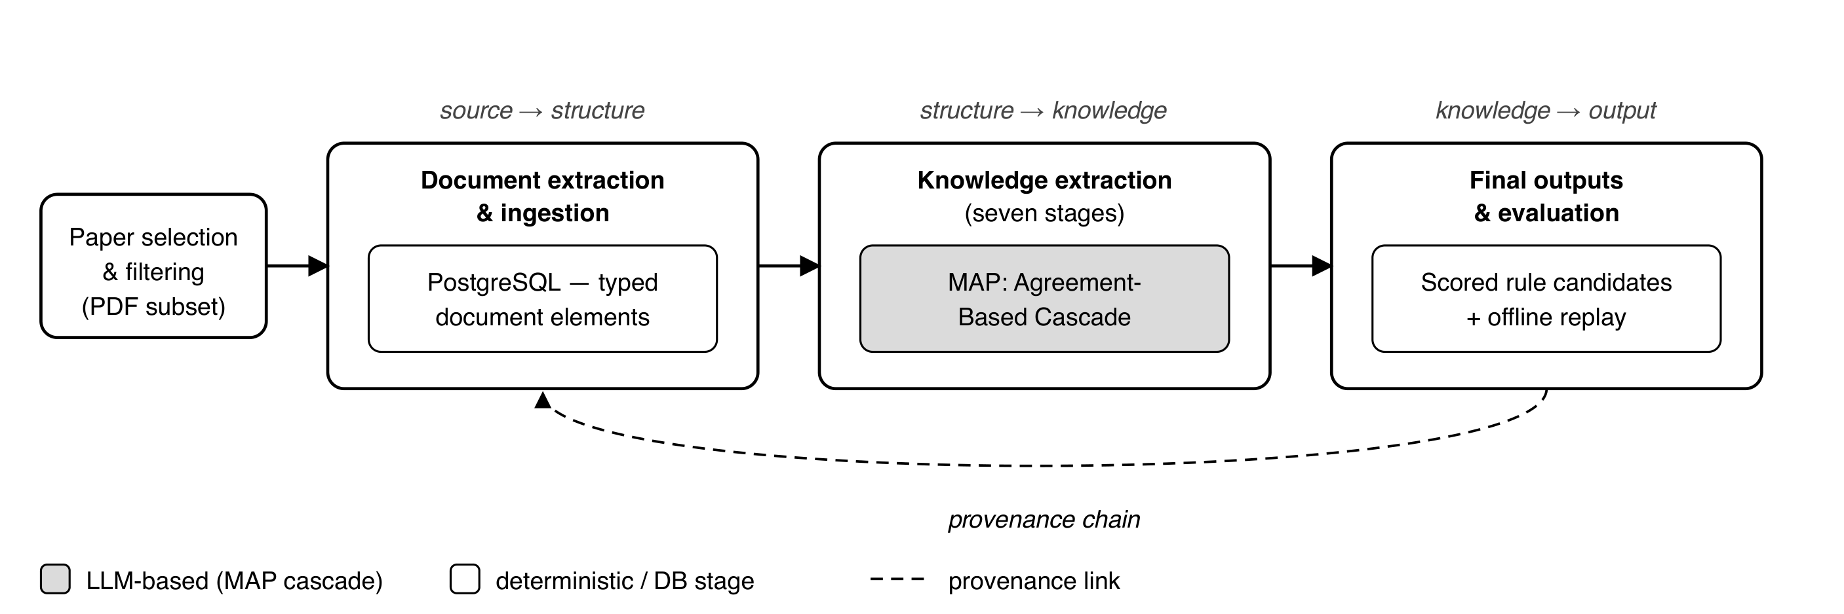
Two pipelines, joined by a database that carries provenance
End-to-end architecture
PMC Open Access PDFs → 977 ingested papers → typed, traceable rule candidates
Provenance chain: final rule → canonical rule → normal finding → MAP finding → text element → document (page, span, coordinates)
Notes:
Four stages. Select and filter from PMC Open Access — 977 papers. Document extraction
turns each PDF into hierarchical text, figure and table crops. Knowledge extraction turns sentences
into typed findings, then rules. Everything is written to artifacts that replay offline.
Take one thing from this diagram: the database in the middle is not storage, it is the provenance
backbone. Every object carries back-pointers — the chain along the bottom — and the data model
enforces it, so it cannot silently break.
The caveat I will repeat: provenance enables auditability. It is not proof of correctness. It tells
you where a claim came from, not that it is true.
[0:50] -> "Let's start at the bottom — turning a PDF into something structured."

Slide 5
Docling plus three targeted fixes, each aimed at a named failure
Docling backbone: sole source of body text, section structure and figure regions
• Hybrid table detection: Docling + TATR, overlapping boxes merged by union
targets tables Docling never proposes, e.g. split across a page boundary
• Footnote expansion: table crop extended downward ×1.2
targets footnotes cut off below a tight crop
• Figure post-processing: icon filter (<50 pt) and a geometric caption matcher
targets logos emitted as figures, and captions attached to the wrong figure
• Two-pass ghost-text removal: invisible text redacted, layout re-extracted
Input is the PDF only: never JATS-XML, by design
Notes:
The backbone is Docling, an open-source layout-aware parser, and it stays the sole
source of body text, section structure and figure regions. I measured it and fixed what it got
wrong.
Three fixes. Table detection: Microsoft's Table Transformer runs alongside Docling and I take the
union of overlapping boxes — threshold-free. Footnote expansion: Docling crops tables tightly and
cuts footnotes off, so I extend the crop down twenty percent. That sounds trivial; it is the single
biggest lever in the document layer. Figure post-processing: a fifty-point size filter and my own
geometric caption matcher.
Fourth, the two-pass extractor: some PDFs carry invisible text under the visible text. I render
each region, test the pixels, redact, and re-run Docling.
[0:50] -> "That's the description. Here is what one failure actually looks like."

Slide 6
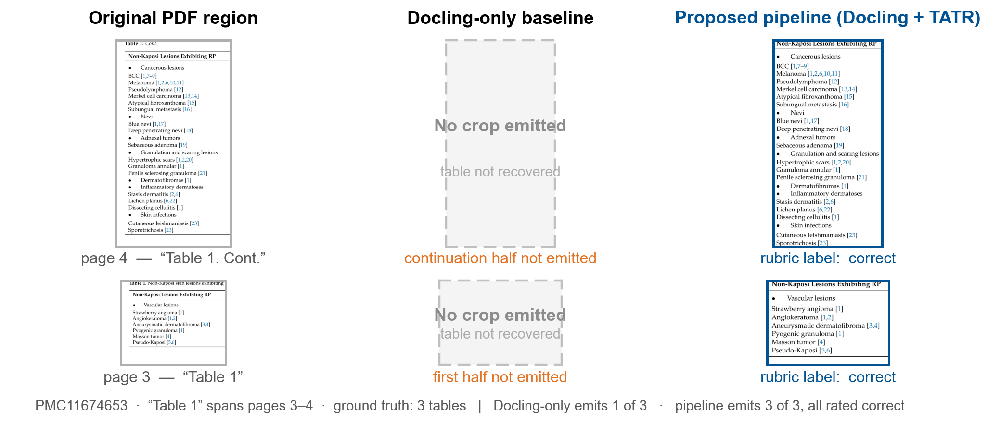
Illustrative extraction example from the evaluation corpus
Illustration only, not additional evaluation evidence. The quantitative result is on the next slide.
Notes:
Illustration, not evidence — the evidence is the rubric numbers shortly. This shows what
those numbers MEAN.
One paper, three tables. Table 1 starts on page 3 and continues on page 4 under "Table 1. Cont." —
an ordinary journal convention.
Left, the region in the PDF. Middle, what Docling-only emitted: nothing. Both halves never
recovered. Right, the hybrid detector emits both, and I annotated each as correct.
The failure generalises: page-by-page detection makes a table spanning a page break look like two
partial tables, and a detector tuned for whole tables proposes neither.
[0:45] -> "Multiply that across 27 papers and four dimensions, and you get RQ1."

Slide 7
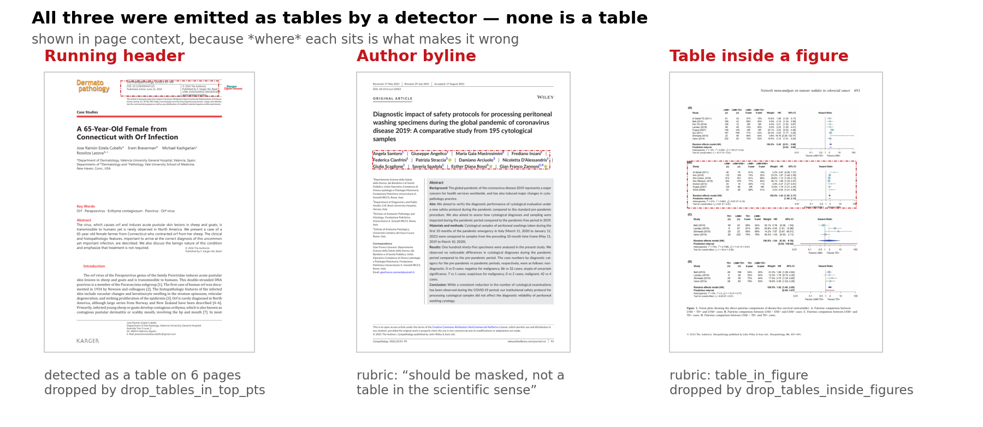
Three things a detector called a table, and none of them is one
Detector false positives suppressed by the pipeline
Corpus-wide: 666 regions dropped by drop_tables_in_top_pts, 67 by drop_tables_inside_figures.
A table detector is a shape detector: ruled boxes with aligned text look like tables whatever they contain.
Notes:
Table detection is shape detection. TATR finds ruled boxes with aligned text and does not
care what is inside them.
I show these in page context because WHERE each sits is what makes it wrong — a cropped byline
looks like a small table.
Three real false positives. Left, a journal running header — rules and columns, detected as a table
on six consecutive pages. Fix: drop any table whose top edge is within fifty points of the page
top; it fires 666 times corpus-wide. Middle, an author byline separated by vertical bars, which is
a grid. Right, a forest plot — there IS a table inside, but it belongs to the figure, and emitting
it separately double-counts and breaks the crop. Dropped by a containment rule.
None of these is clever. Three narrow geometric rules, each removing one recurring class of
nonsense.
[0:50]
[CHECK] slides 7 and 8 still carry the same title — one is probably an accidental duplicate; deleting a slide is your call, not mine.

Slide 8
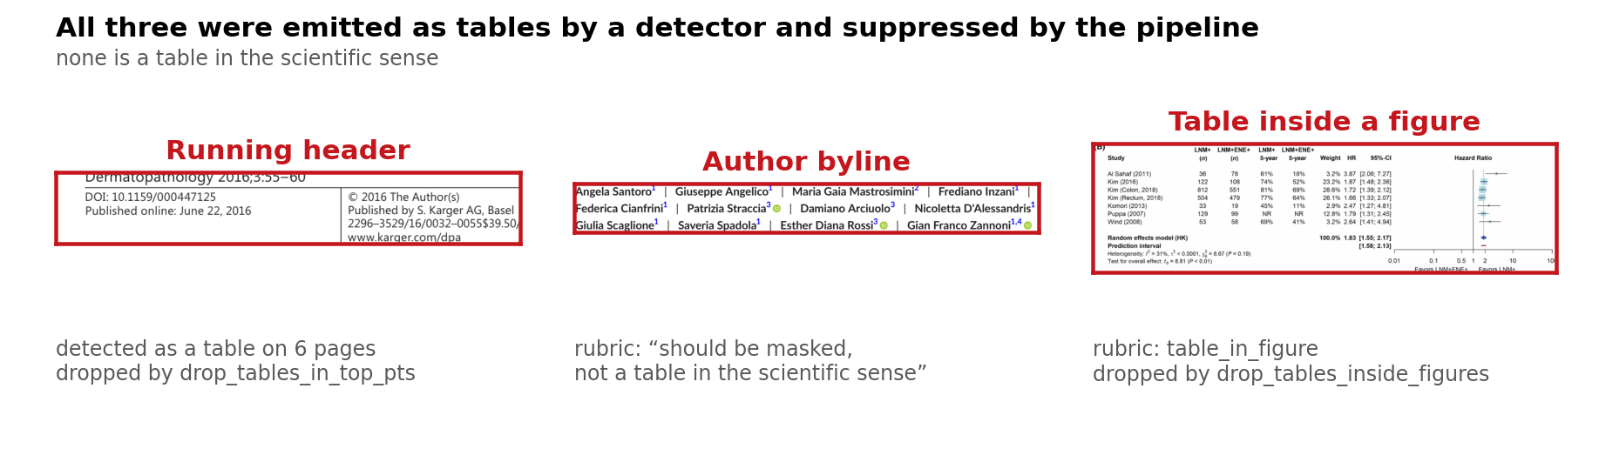
Three things a detector called a table, and none of them is one
Detector false positives suppressed by the pipeline
A journal masthead, an author byline, and a table nested inside a figure.
Notes:
Precision matters as much as recall. Every false table is a region of text removed from
the body — a spurious detection does not just add noise, it deletes real content.
[0:25]
[CHECK] slides 7 and 8 still carry the same title — one is probably an accidental duplicate; deleting a slide is your call, not mine.

Slide 9
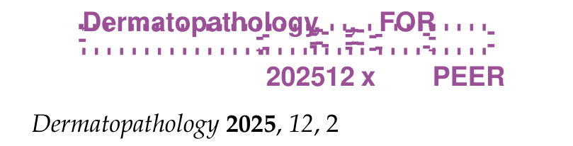
Two-pass extraction removes an invisible “FOR PEER REVIEW” header
PMC11755463 p2 · rule R1_blank_pixels · 45 of 67 nodes on this page rejected
The purple boxes are text Docling extracted. None of it is visible in the rendered page.
The publisher left the pre-publication header “Dermatopathology 2025, 12, x FOR PEER REVIEW” in an invisible layer, on top of the real one.
Detection is pixel-based: render the element's bounding box, test whether anything was actually drawn. 7,595 of 9,836 rejections corpus-wide come from this rule.
Notes:
The fault mode nobody sees, because by definition you cannot see it.
The purple boxes are text Docling extracted. Render the page and none of it is there. The publisher
left the pre-publication running header in the file as an invisible layer — "Dermatopathology 2025,
12, x FOR PEER REVIEW" — sitting on top of the real header. Docling reads the text layer, and the
text layer says both.
My detection is pixel-based, not font-based: render each element's box and test whether anything
was drawn. Blank means invisible, and those text objects are redacted before a second pass. That
rule accounts for 7,595 of 9,836 rejections corpus-wide.
Why it matters: every one of those fragments would otherwise become a sentence and be sent to a
model as content.
[0:50]

Slide 10
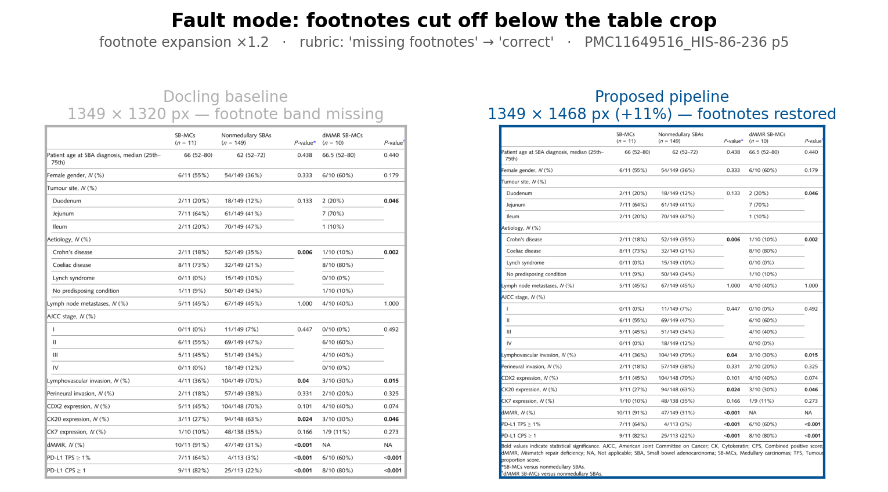
Footnote expansion
Same table, off-the-shelf crop vs the pipeline's
Rubric label moves from 'missing footnotes' to 'correct'. The crop grows downward to absorb the footnote block.
Notes:
Table footnotes carry the abbreviation expansions and the statistical caveats — exactly
the qualifiers a downstream rule needs. A tight crop silently discards them. This one change
accounts for more of the RQ1 gain than anything else.
[0:30]

Slide 11
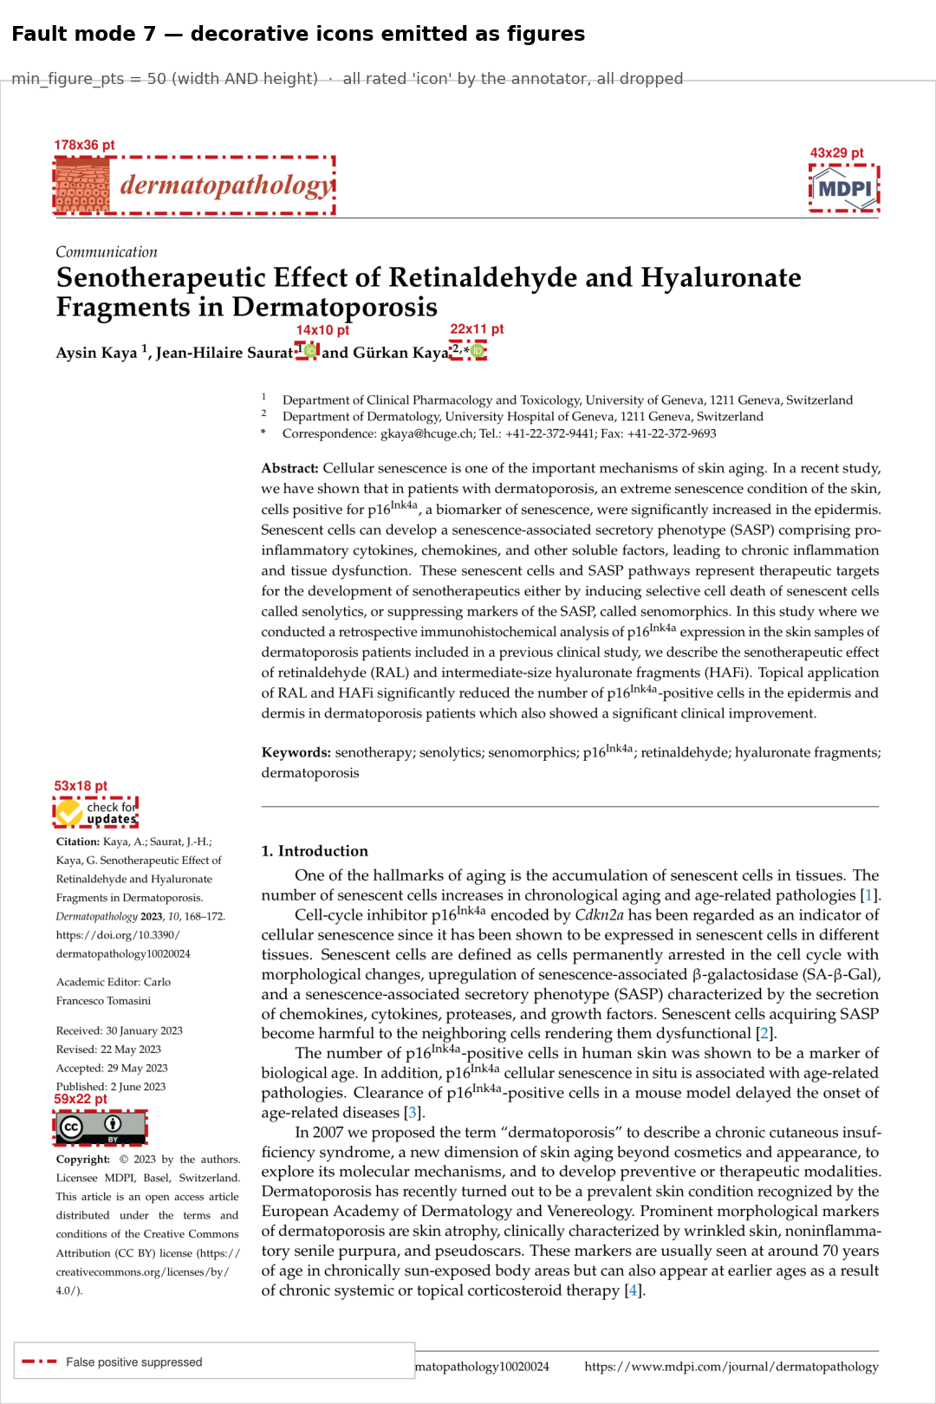
The icon filter
PMC10297671 p1 · every boxed region was rated 'icon' by the annotator
min_figure_pts = 50
width AND height must both reach 50 pt
What Docling emitted as scientific figures:
• two ORCID marks: 14×10 pt and 22×11 pt
• a “check for updates” badge: 53×18 pt
• the CC-BY licence badge: 59×22 pt
• the journal masthead: 178×36 pt
Corpus-wide: 3,065 of 7,544 picture elements dropped (40.6%)
Notes:
The other half of the figure story, and the least glamorous fix in the thesis.
Off-the-shelf Docling emitted 139 figure crops on the rubric set; 73 were rated "icon" — ORCID
marks, the "check for updates" badge, a licence badge, the masthead. Every open-access paper has
these on page one.
The rule is a size filter: width AND height must reach fifty points. The masthead is 178 wide but
36 tall, so it fails on height — that is why it is AND, not area.
Corpus-wide this drops about forty percent of picture elements. With the caption matcher next, these
two account for the whole figure gain.
[0:40]

Slide 12
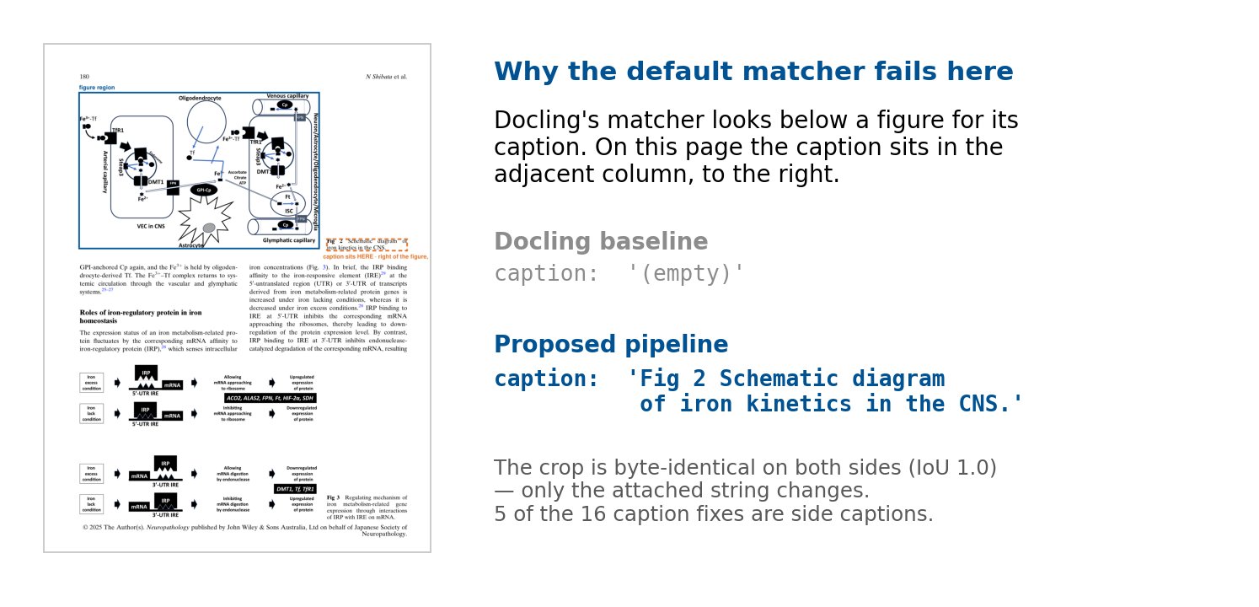
Same pixels, correct caption: the geometric matcher
PMC12129649_NEUP-45-177 p4 · identical bounding box (IoU 1.0), caption string differs
Notes:
The subtlest document-layer fix and the easiest to under-rate.
The figure sits in the left column; its caption is beside it, in the right column. Docling's matcher
searches downward, finds nothing, returns an empty string.
The crop is byte-identical between baseline and pipeline — same box, IoU exactly 1.0. The figure was
never the problem. What changed is the string attached to it.
My matcher scores candidates by edge-to-edge gap in both axes and parses the figure number out of
the caption to check consistency. Sixteen labels corrected on the rubric set; correct captions go
from 60.6 to 90.3 percent.
A caption is not cosmetic. It is the only human-readable description of what a figure shows — the
first thing an auditor reads.
[0:45]

Slide 13
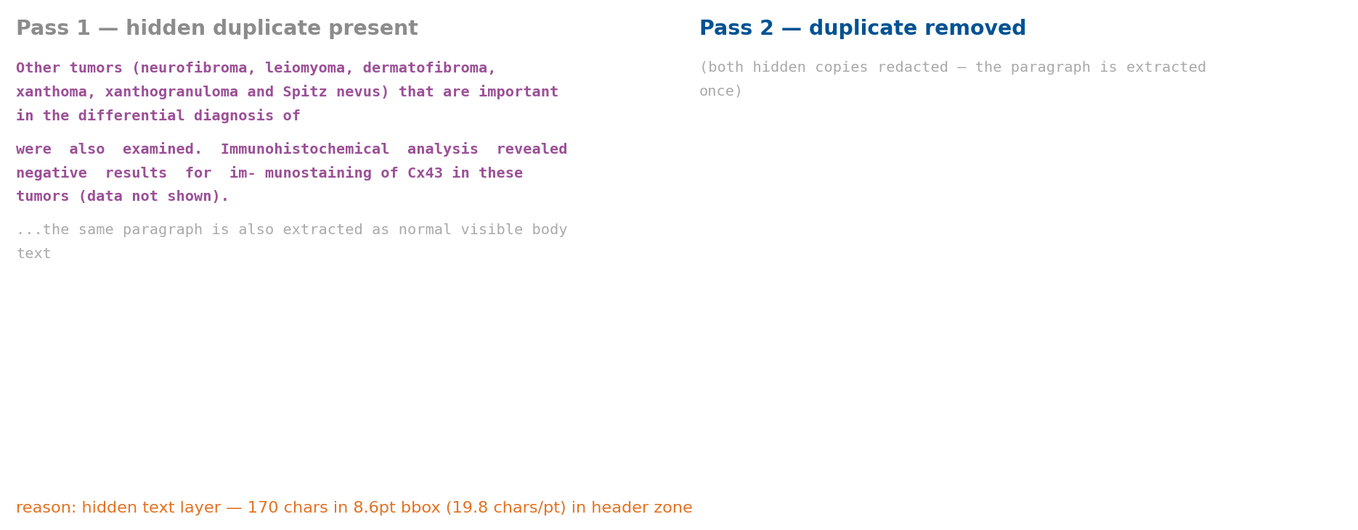
A hidden duplicate paragraph would have been extracted twice
PMC10296831 p4 · rule R3_dense_text · “170 chars in an 8.6 pt box = 19.8 chars/pt”
Notes:
A nastier variant, and this one is real scientific text, not journal furniture.
This paper carries a hidden duplicate of a genuine body paragraph. The visible copy is there; a
second sits underneath in a compressed, invisible layer.
The pixel test does not always catch it, because the hidden copy can overlap real ink. So there is a
second rule — character density. This node claims 170 characters in a box 8.6 points tall, about
twenty characters per point, physically impossible for rendered type.
The consequence if you skip it: the paragraph reaches MAP twice, the model extracts the same finding
twice, and the copies agree perfectly. The cascade sees strong agreement and accepts cheaply. A
duplicate looks exactly like corroboration.
That is why this stage exists — not tidiness, but not manufacturing false support.
[0:45]

Slide 14
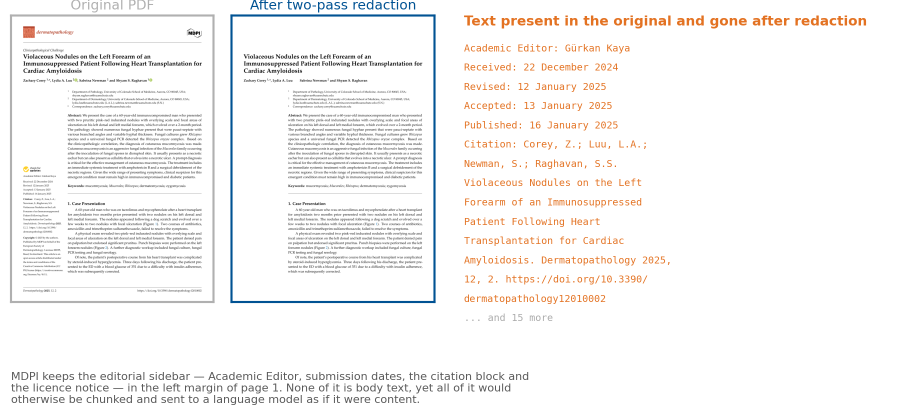
End result before the text assembly stage
Left: the page as published. Right: what the pipeline redacts before reading it.
Running headers, footers and side matter are removed geometrically, before any text assembly.
Notes:
The slide that earns the document-extraction half of the thesis. Nobody expects a PDF to
be hostile.
Point at the sidebar: Academic Editor, received and accepted dates, the citation block. All of it
would otherwise land in body text and be extracted as a finding.
[0:30]

Slide 15
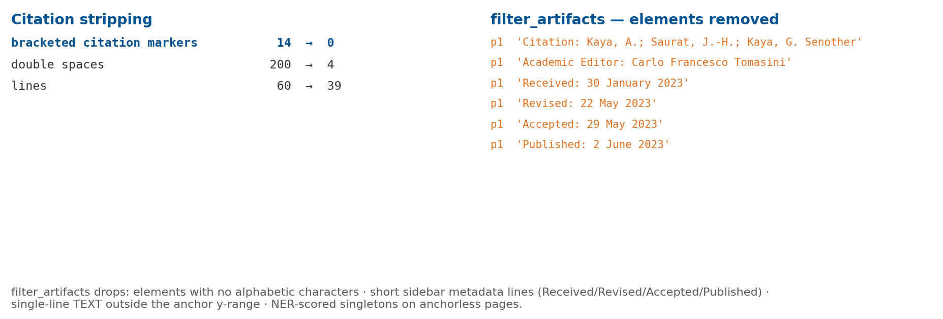
Text assembly also strips citations and layout artifacts
out/text_raw (pre-assembly) vs out/text (assembled)
Notes:
Two smaller cleanup stages during text assembly.
Citation stripping: bracketed markers removed, double spaces collapsed. A citation mid-sentence
corrupts the sentence segmentation MAP depends on, and the marker carries no meaning out of context.
filter_artifacts: drops elements with no alphabetic characters, short sidebar metadata lines, and
single-line elements outside the vertical range of the page's anchor blocks.
Two honest caveats. This overlaps with the header/footer masking — belt-and-braces rather than
elegance. And the NER-based rule is the only place in the document layer where a model decides what
to keep; I did not evaluate it separately.
[0:40]

Slide 16
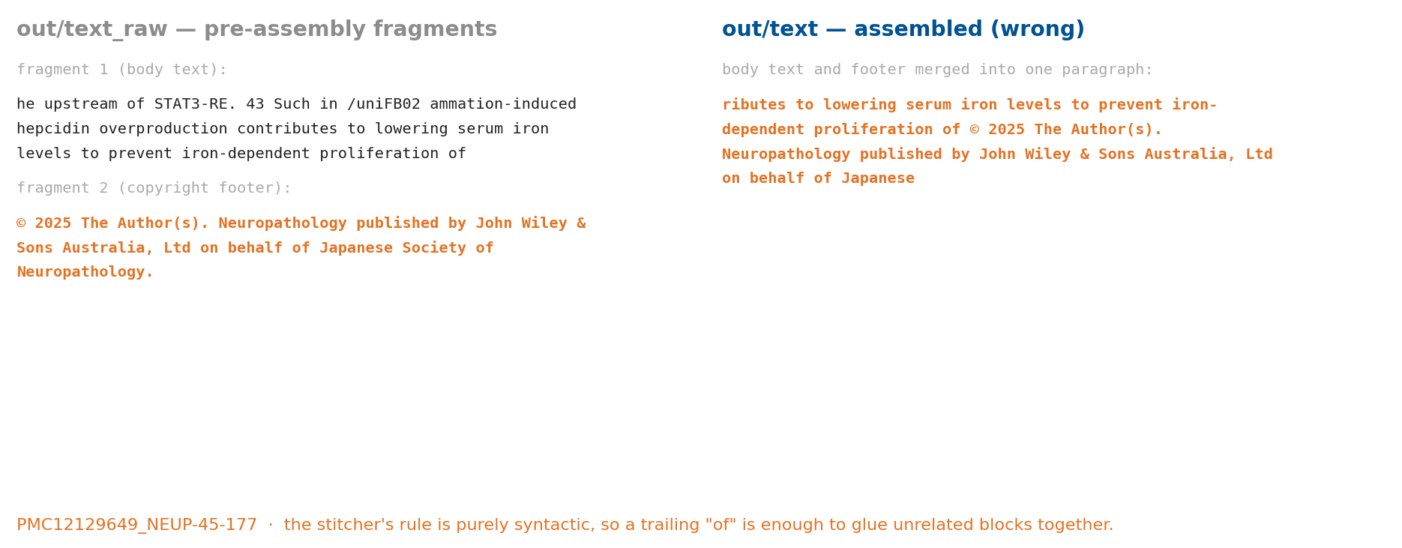
Paragraph stitching is purely syntactic, which cuts both ways
ContextAwareStitcher · out/text_raw vs out/text
Merge errors leave no signal in the rubric, because the rubric only scores crops.
Notes:
Layout parsers return paragraphs in fragments — broken by a column boundary, a page
break, a floating figure. The stitcher rejoins them on syntactic cues: a trailing hyphen, comma or
connective; a fragment starting lower-case.
It works — I verified ten clean joins on the rubric set.
But the rule is purely syntactic, and this is the failure. A sentence ends "...proliferation of" —
trailing "of", so the stitcher looks for a continuation. The next element in reading order is the
copyright footer, and it glues them together.
The status matters: the thesis already says paragraph-merging errors happen without leaving a signal
in the rubric evaluation — the rubric scores crops, not prose, so this class is invisible to my own
RQ1 metric. What I add is a concrete instance. I do not know the rate.
[0:45]

Slide 17
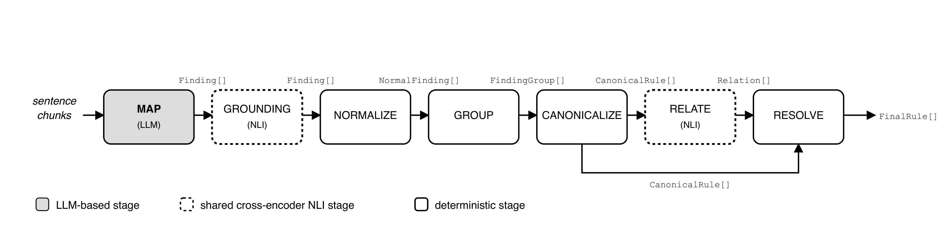
Seven stages, only the MAP stage is stochastic
MAP → GROUNDING → NORMALIZE → GROUP → CANONICALIZE → RELATE → RESOLVE
Only MAP calls a language model. Every later stage merges, selects or scores deterministically.
Typed MAP finding: claim · subject/outcome entity · relation type · direction · category · scope · verbatim evidence · confidence
The verbatim support is overwritten with the source text looked up from the database. A quoted span cannot be hallucinated.
Notes:
Seven stages. MAP is the only one that calls a language model: ten consecutive sentences
in, typed findings out against a strict schema — claim, subject and outcome entities, relation type,
direction, category, scope, and a verbatim evidence span.
GROUNDING checks each claim against the paragraph it cites with an NLI model. NORMALIZE maps entities
to canonical forms and UMLS ids. GROUP collects findings sharing subject, outcome, relation and
category. CANONICALIZE picks one representative per direction — lossless. RELATE finds support and
contradiction. RESOLVE scores.
Underline the bold line: after MAP, nothing generates text. Every downstream stage merges, selects or
scores. That is the structural reason provenance survives. One safeguard: after MAP returns, I
overwrite the model's quote with the real source text from the database.
[0:50] -> "MAP is the stochastic step and the expensive one — so that's where the cascade goes."

Slide 18
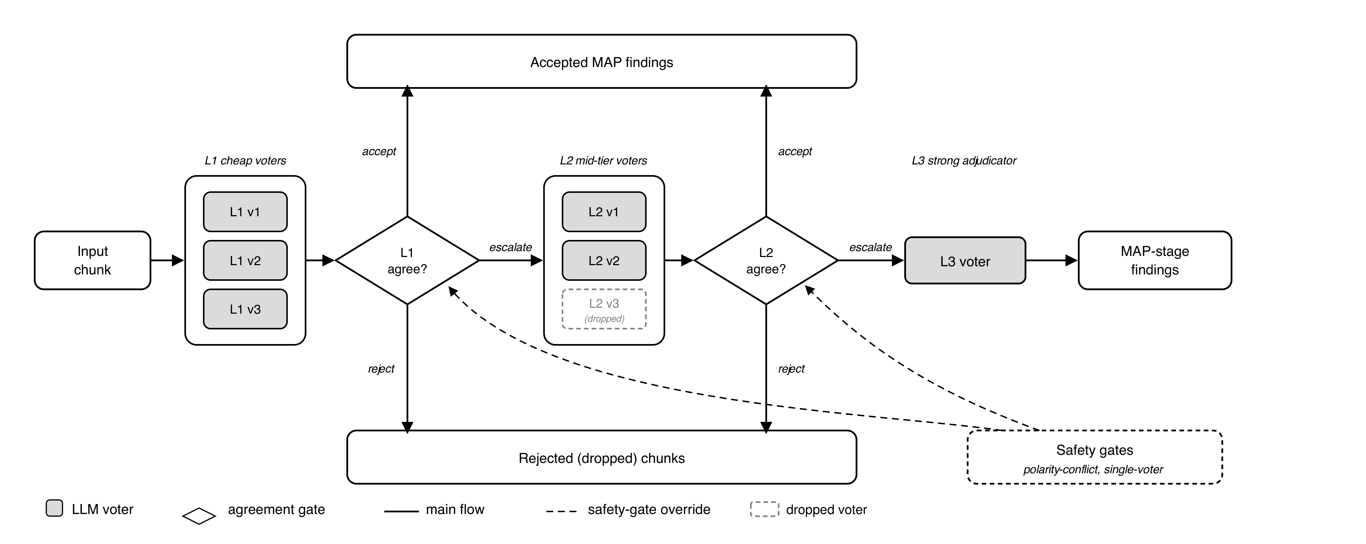
Agreement-Based Cascading: cheap voters decide; the strong model is called on disagreement
Agreement-based cascading at the MAP stage, integrated and calibrated after Kolawole et al. (2025)
L1 – 3 cheap voters
Gemini Flash-Lite · GPT-4o mini · GPT-4.1 nano: parallel, every chunk
L2 – 2 mid voters
Gemini Flash · GPT-4.1 mini: only on L1 disagreement
L3 – Claude Sonnet 4.6
unconditional accept, no scorer applied
accept if s ≥ θ · reject if s ≤ θ_reject · otherwise escalate
All voters at temperature 0: diversity comes from providers, not from sampling
Notes:
The cascade sits on MAP. Three cheap voters from OpenAI and Google run on every chunk. A
scorer builds a pairwise similarity matrix, takes each voter's mean similarity to the others, and the
agreement score is the MAXIMUM of those means — so the winner is the output most aligned with
consensus.
That drives a three-way decision. Above theta, accept and stop. Below a reject threshold, emit
nothing. In between, escalate — two mid-tier voters, then Claude Sonnet, whose output is accepted
unconditionally.
Two design points that matter for the results. Every voter runs at temperature zero: the diversity is
PROVIDER diversity, not sampling noise. And — I flag it now because it predicts the negative result —
if the cheap voters disagree often you pay for them AND the strong model. The cascade is only cheaper
if agreement is common. Hold that thought.
[0:55] -> "That's the system. Now — how do you evaluate it honestly?"

Slide 19
How the agreement scorer picks a winner
Max-consensus over an N×N similarity matrix, no ground truth involved
• Each voter returns a set of typed findings for the chunk
• Align every pair of voters one-to-one, then score the alignment: the `hybrid` scorer blends four signals:
0.50 biomedical entity overlap 0.30 claim-embedding similarity
0.15 category agreement 0.05 cited-evidence overlap
• Each voter's score = its mean similarity to the others; the chunk's agreement score = the maximum of those means
• The winner is the most consensus-aligned voter. Ties break on grounding quality: fraction of findings with a non-empty evidence chain, then sources per finding.
The score measures agreement, not correctness. Voters can agree, and all be wrong, which is exactly why GROUNDING runs afterward.
Notes:
The machinery behind accept/reject/escalate, and worth being precise because the cost
argument rests on it.
Every voter returns a set of typed findings, not a string — so "do they agree?" is not string
comparison. I align the two sets one-to-one and score the alignment. The winning scorer blends four
signals, weights on the slide: entity overlap dominates at 0.50, claim embedding 0.30, category 0.15,
cited evidence 0.05. Entity-heavy was selected empirically, not by hand.
Each voter takes its mean similarity to the others; the chunk score is the maximum, and the winner is
the voter that achieved it. Ties break on grounding quality.
Underline the last line: this measures agreement, not correctness. If all five voters share a
misconception they agree strongly and the cascade accepts confidently and cheaply. Nothing in the
scorer detects that — which is why grounding runs afterwards.
[0:50]

Slide 20
Grounding: every claim is checked against the sentence it cites
One frozen NLI model, no fine-tuning
• MAP returns a claim plus the verbatim sentence it came from
• An NLI model scores entailment on that pair; below 0.5 the finding is dropped
• The model is PubMedBERT-MNLI-MedNLI, used as is
the same model is reused later for relation classification
• This is the check that catches a fluent, well-formed, unsupported claim
Notes:
Grounding is where an unsupported claim dies, and it costs real recall — six strict-F1
points, which I report rather than hide. I kept it anyway. An ungrounded rule in this domain is worse
than a missing one.
[0:30]

Slide 21
Four frozen datasets: one human-labeled, three LLM-labeled
Dataset | Size | Construction | Labels | RQ
Ingested corpus | 977 papers | PMC OA keyword filter, single-PDF, ≤30 pages | — | —
Doc-extraction rubric set | 27 PDFs | manually selected, frozen, disjoint | human (1 annotator) | RQ1
related15 calibration | 15 papers · 454 cases · 2,223 silver | exhaustive ILP over inter-paper relatedness | silver (Opus 4.7) | RQ2, RQ3
heldout15 evaluation | 15 papers · 285 cases · 1,657 silver | random sample, disjoint from calibration | silver (Opus 4.7) | RQ5
Relation claim pairs | 300 pairs (100 per class) | generated label-first, independent of corpus | synthetic silver | RQ4
Only RQ1 rests on human labels. RQ2–RQ5 measure agreement with Claude Opus 4.7.
Notes:
Four frozen datasets, and the disclosure goes on the table before any result.
977 histopathology papers from PMC Open Access. The RQ1 rubric set is 27 PDFs I annotated by hand
against a written four-dimension rubric — the only human labels in the thesis, annotated by me alone.
The calibration cluster is fifteen papers chosen by an integer linear program maximising pairwise
relatedness. The held-out set is fifteen more, random and disjoint. The relation set is three hundred
synthetic pairs, generated label-first.
The orange column is the honest part. For everything except RQ1 the labels come from Claude Opus. So
strict-F1 of 0.716 means agreement with Opus — not with a pathologist. No experiment in this thesis
lifts that bound.
Note also: 2,223 is the count of SILVER findings; the 2,294 on the next slide is PIPELINE findings.
Different quantities.
[0:55] -> "Starting with the one place I do have human labels — RQ1."

Slide 22
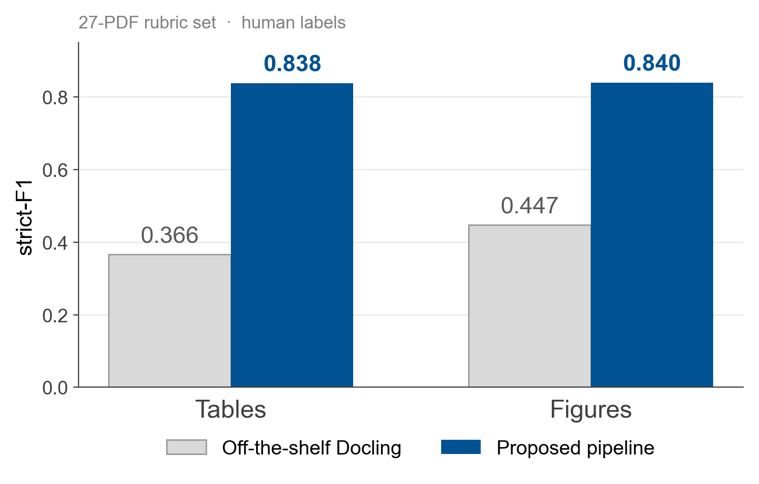
RQ1: Footnote capture and figure post-processing roughly double strict-F1
27-PDF rubric set · human labels · strict-F1 requires every applicable dimension to be perfect
• Tables 0.366 → 0.838. The lever is footnote precision, 43.8% → 91.4%
• Detector alone 0.400 → 0.420 · + footnote expansion 0.800 · + hybrid and geometry fixes 0.838
• Figures 0.447 → 0.840. Icon filter (63 crops) and caption matching (16 fixes)
• Decorative-icon false positives 73 → 14; emitted crops 139 → 76
Cost of footnote expansion: table mask-F1 94.3% → 91.9%
Notes:
The only slide backed by human labels, and the metric is deliberately harsh. Strict-F1
counts a table as a true positive only if it is perfect on EVERY applicable dimension — geometry,
caption, footnote, masking. A near-miss earns zero.
Tables 0.366 to 0.838. Figures 0.447 to 0.840. Roughly double, on both.
The attribution matters more than the headline. The second detector alone moves strict-F1 from 0.400
to 0.420 — almost nothing. Footnote expansion alone gets you to 0.800. Together, 0.838. The dominant
lever is FOOTNOTES; the hybrid detector recovers tables missed entirely, which is a smaller
population but the one that matters for recall.
For figures the gain is post-processing, not detection: the icon filter cuts false positives from 73
to 14, the caption matcher takes correct captions from 61 to 90 percent. The thesis names a third
mechanism, sub-figure merging; after submission I verified it never runs.
One honest cost: expanding crops downward drops mask-F1 from 94.3 to 91.9. I took that trade
knowingly.
One number that defends the hybrid detector better than that +0.020, which is measured before
footnote expansion. With the same footnote expansion and geometry fixes, swapping only the
detector: TATR alone 0.649, hybrid 0.838. The union is what keeps Docling's own proposals.
[1:05] -> "So the document layer works. What does the knowledge layer produce on top of it?"

Slide 23
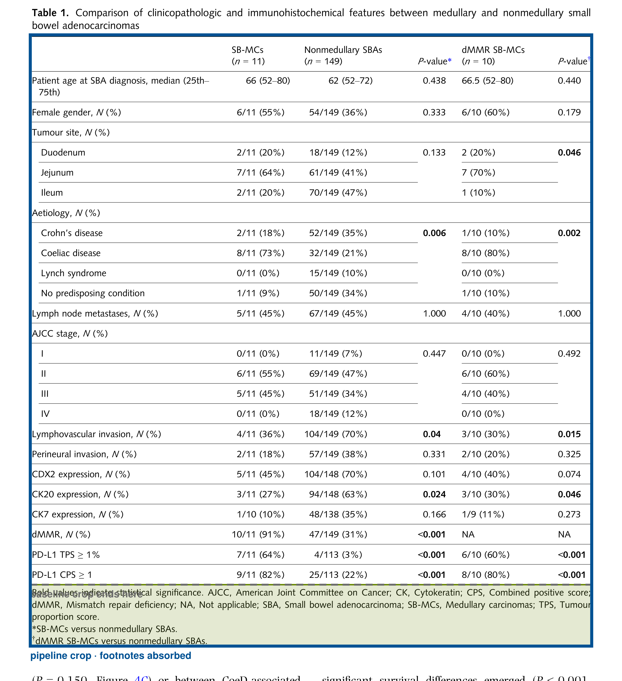
The effect of footnote expansion on table strict-F1
PMC11649516_HIS-86-236 p5 · rubric label 'missing footnotes' → 'correct'
43.8% → 91.4%
footnote precision, 27-PDF rubric
• Crop grows 1320 → 1468 px (+11%)
• 14 regions fixed on the rubric set
• Alone it takes strict-F1 to 0.800
Cost: mask-F1 94.3% → 91.9%, because a larger crop sometimes covers text that should have stayed.
Notes:
The mechanism behind the RQ1 headline, and it is almost embarrassingly simple: extend the
table crop downward twenty percent and re-check what falls inside.
The green band is what the pipeline added — the significance note, the abbreviation key, the dagger
footnotes. Docling's crop stops at the last data row, a reasonable definition of "the table" and
completely wrong for downstream use.
Footnote precision goes from 43.8 to 91.4 percent. On its own this takes table strict-F1 from 0.400
to 0.800 — worth more than the second detector by a wide margin.
The honest cost is on the right: a bigger crop sometimes swallows body text, so mask-F1 drops about
two and a half points.
[0:40]

Slide 24
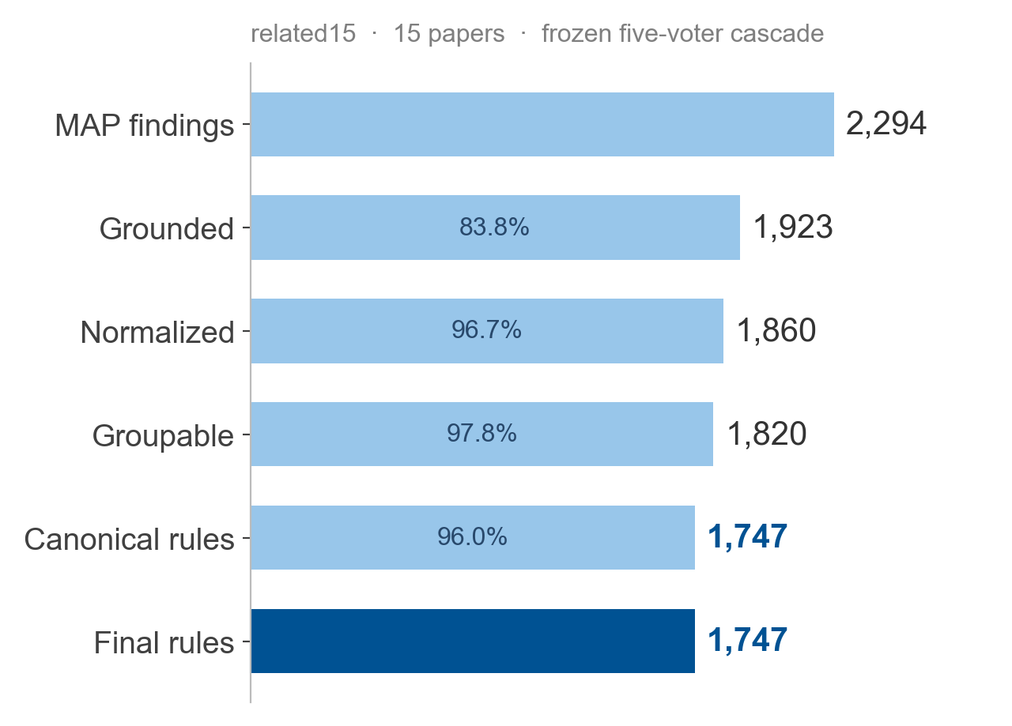
RQ2: 1,747 rules, and every one traces back to a source paragraph
related15 · frozen five-voter cascade · θ = 0.9, θ_reject = 0.2, grounding 0.5
100%
of final rules resolve to ≥ 1 source paragraph in their own paper (1,747 / 1,747)
• Figures and tables carry page + bounding box: 100%
• All tables carry a caption; figures with captions 86.3%
• Measured corpus-wide: 977 documents · 35,896 text elements · 4,479 figures · 1,960 tables
Cross-reference linking resolves for 53.6% of figures and 58.9% of tables, but is not used downstream
Notes:
Fifteen papers, frozen configuration. MAP produces 2,294 findings — PIPELINE findings,
not the 2,223 silver labels. Grounding removes about sixteen percent. Everything after barely moves
the count, and we end with 1,747 rules, about 117 per paper.
The shallow funnel is itself a finding: the findings leaving MAP are already mostly atomic and
distinct. Had they been redundant, consolidation would have collapsed them.
The number I would defend hardest is on the right. All 1,747 rules resolve to at least one source
paragraph — not 99 percent, all of them. That is structural: a rule cannot exist in the data model
without its back-pointer chain.
Two honest gaps in grey. Only 86 percent of figures have a caption attached. And cross-reference
linking resolves about half the time — not used downstream, but not solved.
[0:50] -> "Those rules came out of the cascade. Was the cascade worth it?"

Slide 25
What one extracted rule actually looks like
Field | Value
subject_entity / outcome_entity | PHH3 → Continuance of life
relation_type / direction / category | prognostic / negative / prognosis
predicate_text | PHH3 → independent predictor of survival in a Cox regression model
mean_grounding_score | 0.9997 (NLI entailment against the cited paragraph)
final_score / score_mode | 0.6198 / relations_present
finding_count / support_count | 2 / 1 study_coverage: single_study
member_normal_ids | NF_PMC10100421_…_ff259926, NF_PMC10100421_…_4a2e8baa
supporting_pmcids | PMC10100421_HIS-82-393
is_conflicted | True — the group holds more than one polarity
Every ID is a live back-pointer: final rule → canonical rule → normal findings → MAP findings → text elements → page and coordinates.
Notes:
One actual rule, verbatim from the frozen output.
Subject PHH3, a mitosis marker. Outcome survival. Relation prognostic, direction negative. The
predicate is the model's own compressed statement. The grounding score is 0.9997 — the NLI model
checking the claim against the paragraph it cites.
Two fields to draw out. The ID chain: member_normal_ids points at the normalized findings this was
built from, which point at MAP findings, which point at text elements carrying page and bounding box.
That is provenance as data, not documentation.
And is_conflicted is True — the source group contained more than one polarity. The system does not
silently pick a winner; it flags the group and keeps both directions, because the point is to surface
candidates for a human.
The final score of 0.62 is a ranking signal, not a probability.
[0:45]

Slide 26
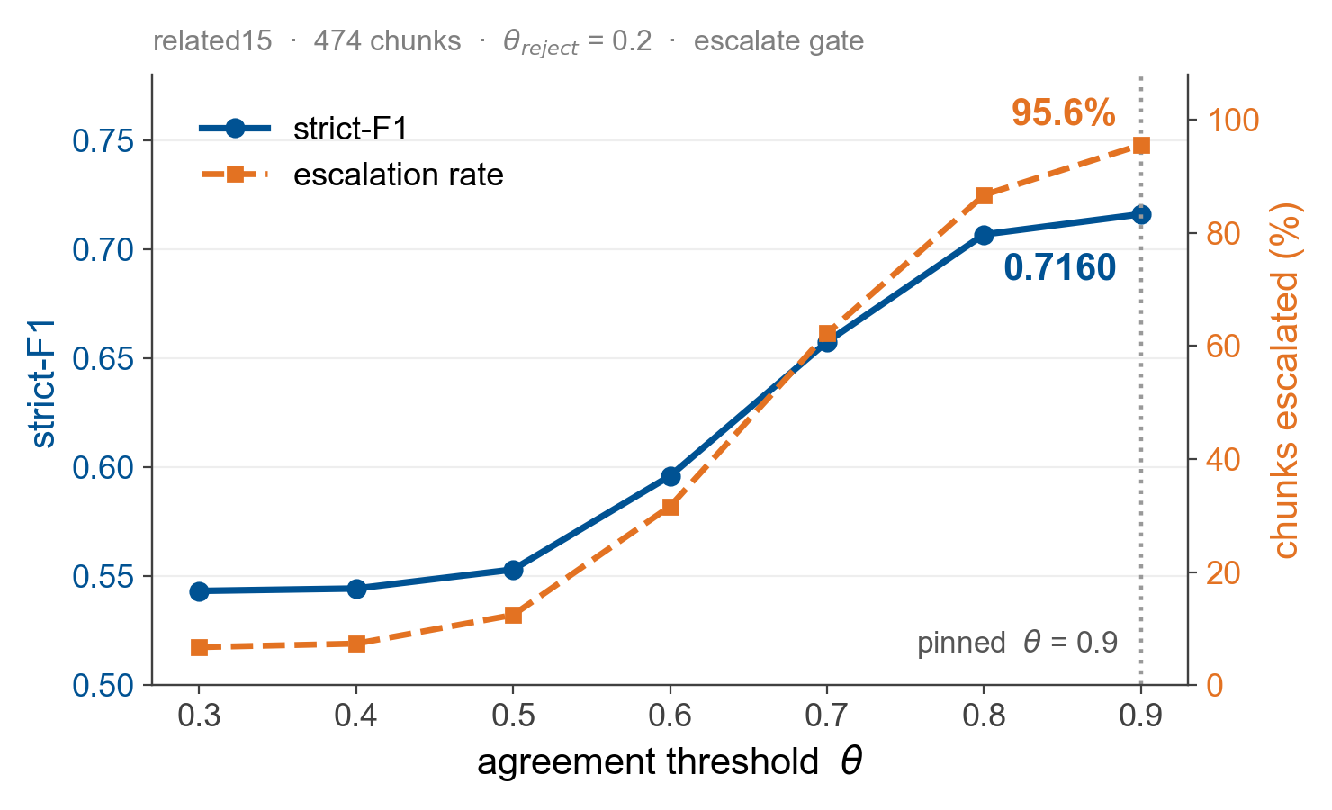
RQ3a: Top cascade quality requires near-universal escalation
Calibration on related15 · 474 chunks · strict-F1 vs Opus silver, optimal (Hungarian) matcher
Pinned operating point
θ = 0.9, θ_reject = 0.2
strict-F1 0.7160
at 95.6% escalation
θ 0.7 → 0.8: +≈0.05 strict-F1
θ 0.8 → 0.9: +0.0085 strict-F1, +8.5% cost
At θ = 0.9 the cheap voters resolve about 1 chunk in 20 on their own.
Notes:
Calibration on fifteen related papers, 474 chunks.
Blue is quality against theta. It rises then flattens — 0.7 to 0.8 buys about five points of
strict-F1; 0.8 to 0.9 buys 0.0085. Less than one point.
Orange is why this slide exists. Escalation climbs with theta, and at my operating point, theta 0.9,
95.6 percent of chunks escalate. Almost every chunk reaches Sonnet anyway.
State the implication plainly rather than let them find it: at that setting the cascade is barely a
cascade. It is a strong model with an expensive pre-filter. The cheap voters are paid for on every
chunk and resolve about one in twenty on their own. That is not a tuning bug — it is what agreement
looks like when the schema is rich and voters genuinely disagree.
So: should you just call the strong model directly?
[0:50] -> "That question is RQ3 — the thesis's central negative result."

Slide 27
How the shipped configuration was chosen: six experiments, in order
# | Question | Outcome
E05 | Which embedder, scorer and alignment? | hybrid scorer beats plain embedding on every embedder
E06 | How should the hybrid signals be weighted? | Gemini + hybrid + greedy, entity-heavy blend → 0.7133
E06b/c | Can any voter be dropped? | drop Claude Haiku: F1-neutral, −18% cost per chunk
E07 | Where should θ and θ_reject sit? | θ = 0.9, θ_reject = 0.2 → 0.7147
E08 | Do the accept/escalate gates matter? | escalate 0.7160 vs keep 0.7147 (within noise)
E08b | Final curve at the shipped setting | 0.7160 at 95.6% escalation
Order matters: each experiment fixes one knob and passes the rest forward, so the search is linear rather than combinatorial.
Every one of these replays from cached voter outputs: no new API calls, no cost, byte-identical results.
Notes:
Whether the shipped configuration was tuned or just picked. This is the audit trail.
Six stages, each fixing one knob and handing the rest forward. E05 screens the structural choices —
twelve combinations — and the structured hybrid scorer beats plain embedding on every embedder, the
cleanest result in the calibration. E06 refines the blend weights. E06b and E06c ask whether any
voter earns its place; dropping Claude Haiku is quality-neutral at eighteen percent lower cost, which
is how six voters became five. E07 sweeps thresholds, E08 ablates the gates, E08b gives the final
curve.
Two things I would defend. The order is deliberate — one knob at a time makes the search linear
rather than combinatorial, at the cost of assuming the knobs are separable. That assumption is not
tested.
And all six replay from cached voter outputs. Every number regenerates on a laptop with no network
and no spend, byte-identical.
[0:45]

Slide 28
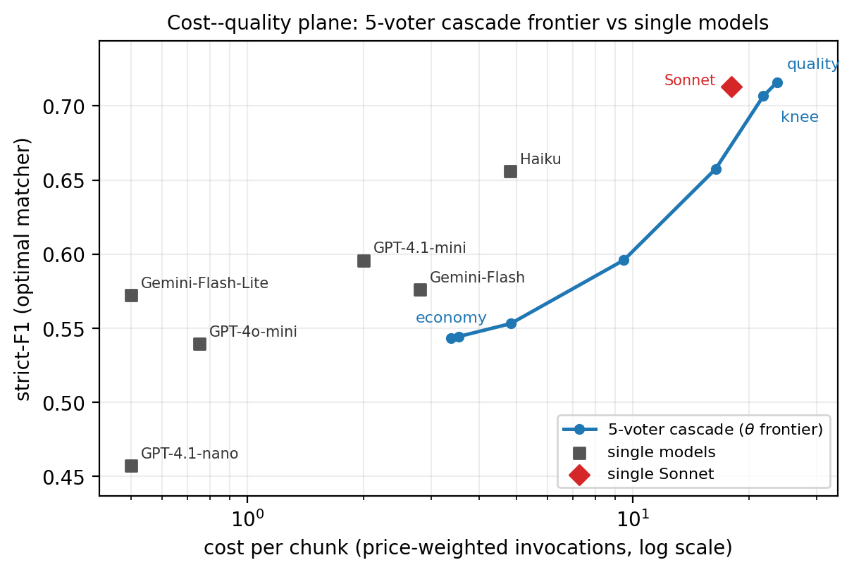
RQ3b: The cascade ties the best single model, which costs 24% less
Paper-level clustered paired bootstrap, B = 10,000 · cost in price-weighted units per chunk (the thesis states no currency)
Cascade 0.7160 at 23.66
Single Sonnet 0.7129 at 18.00
Δ = +0.0031 95% CI [−0.0002, +0.0068]
not statistically significant
• vs. every cheaper model: +0.060 to +0.26, all significant
Not cost-justified against the single strong model. Decisively better than every cheap one.
Counter-consideration: Sonnet shares a model family with the Opus silver labeler, so the measured gap is arguably conservative.
Notes:
The result I would lead with if I could report only one, and it is negative.
The cascade at its best reaches 0.7160 at a cost of 23.66 per chunk. A single Claude Sonnet call
reaches 0.7129 at 18.00. The difference is +0.0031, and the ninety-five percent interval from a
paper-level clustered paired bootstrap — ten thousand resamples, papers as the unit — runs from minus
0.0002 to plus 0.0068. It crosses zero. THIS IS NOT A STATISTICALLY SIGNIFICANT IMPROVEMENT. And the
single model is about twenty-four percent cheaper.
So under the silver cost-quality criterion the cascade is not cost-justified against the strong single
model. I say it in those words because it would be easy to call 0.7160 versus 0.7129 "the cascade
wins" and technically not be lying.
The other half is real too. Against every OTHER single model the cascade wins by six to twenty-six
points, all significant. The next best, Haiku, trails by more than six. So this is not "the cascade
doesn't work" — it is "the cascade doesn't beat the one model that is already very good and already
cheaper".
One counter-consideration, carefully. The silver labels come from Opus; the Sonnet baseline is also
Anthropic. There is a plausible family-resemblance advantage, and my five voters are entirely
non-Anthropic — so the measured gap is arguably conservative. But I did NOT measure that. It does not
turn a null result into a positive one.
On cost units: a price-weighted unit from a hand-compiled price book of list prices. The thesis states
no currency — a genuine gap in the write-up.
[1:20] -> "RQ4 is a cleaner result: one frozen model doing two jobs."

Slide 29
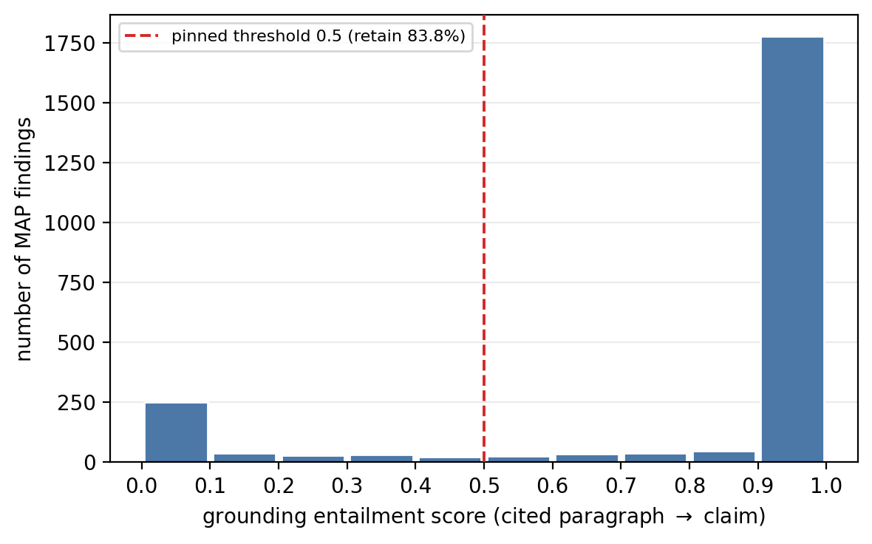
RQ4: One frozen NLI model, two roles: grounding costs 6 F1 points
pritamdeka/PubMedBERT-MNLI-MedNLI — frozen, no fine-tuning, shared by GROUNDING and RELATE
Relation classification
synthetic 300 pairs, 100 per class, thresholds frozen at 0.50 / 0.50
accuracy 0.923
macro-F1 0.924 (production scope_aware mode)
• SUPPORT precision 1.000, F1 0.953
• CONTRADICT F1 0.922
• UNRELATED F1 0.897
Class-balanced synthetic set: an optimistic ceiling, not a corpus-representative estimate.
Grounding
Bimodal: 77.5% score ≥ 0.9, ≈ 14% < 0.3. Threshold 0.5 retains 83.8%; strict-F1 0.716 → 0.652; precision flat (0.872 → 0.875).
Of the 371 findings removed, ≈ 86% agreed with the Opus silver: traded knowingly for source faithfulness.
Notes:
One model, frozen, no fine-tuning: a PubMedBERT cross-encoder trained on MNLI and MedNLI,
doing two jobs.
Grounding first. For each claim I run entailment against the paragraph it cites. The distribution is
strongly bimodal — 77.5 percent above 0.9, about 14 percent below 0.3. Little in the middle, which is
reassuring.
Now the honest part. Turning the filter OFF gives the best strict-F1, 0.716. At 0.5 it drops to 0.652
— six points. And of the 371 findings removed, about 86 percent actually agreed with the silver
labels.
I kept it, and I defend that rather than apologise. The filter enforces that a claim is entailed by
the text it points at. A finding that agrees with Opus but is not supported by its own cited paragraph
is exactly the failure this thesis exists to prevent. Six points of agreement-with-a-labeller, traded
for a property the labeller cannot measure.
Job two is relation classification — about 92 percent on three hundred synthetic pairs. But read the
orange caveat: class-balanced, synthetic, label-first. An optimistic ceiling.
[0:55] -> "Does any of this survive on papers I didn't calibrate on?"

Slide 30
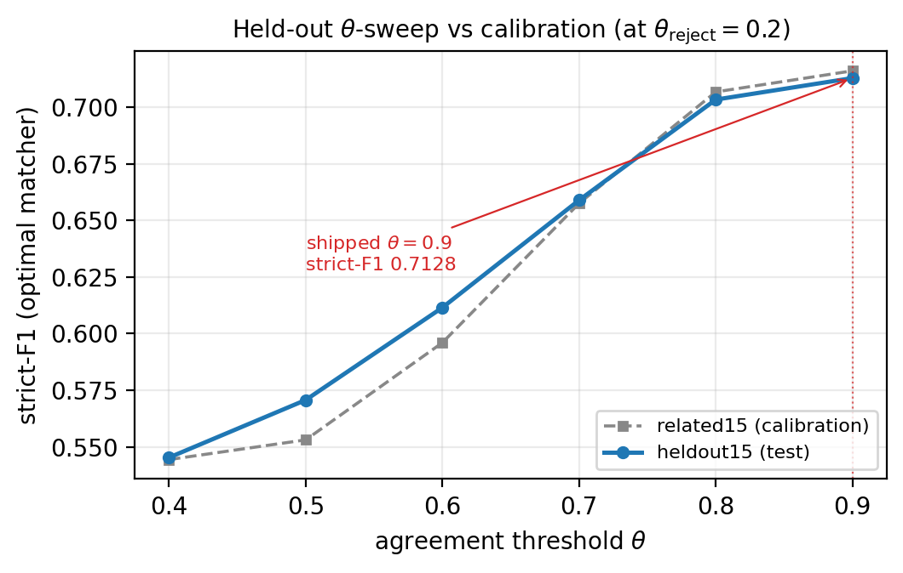
RQ5: Held-out performance sits within noise of calibration
Heldout15: 15 papers, disjoint, random sample · configuration frozen before evaluation
 | related15 | heldout15
Strict-F1 | 0.7160 | 0.7128
Loose-F1 | 0.886 | 0.884
Precision | 0.872 | 0.880
Recall | 0.900 | 0.888
Escalation | 95.6% | 99.0%
Rule provenance | 100% | 100%
Gap = 0.0032: within the bootstrap noise band
Escalation rises to 99.0%: on unfamiliar papers the cheap voters agree even less often. θ was fixed after calibration, so the sweep is descriptive only.
Notes:
Fifteen new papers, random, disjoint. The configuration was frozen before I ran this —
theta, voters, weights, thresholds.
Strict-F1 goes from 0.7160 to 0.7128 — a gap of 0.0032, inside the bootstrap noise band. The funnel
keeps its shape, and provenance is again a hundred percent: 1,273 of 1,273.
Read the left curve carefully: it is DESCRIPTIVE. I did not tune theta on the held-out set — that
would defeat the purpose.
One number moved: escalation goes from 95.6 to 99.0 percent. On unseen papers the cheap voters agree
even less. That reinforces the RQ3 conclusion rather than softening it — the economics get worse on
unfamiliar material.
The claim this licenses is narrow: the configuration does not overfit related15. It does NOT show
generalization to other subfields, non-PMC papers, or non-English literature.
[0:45] -> "Which brings me to what these numbers do not support."

Slide 31
Every number after RQ1 measures agreement with an LLM, not a pathologist
Limitations and threats to validity
• Silver labels bound everything.
RQ2–RQ5 measure agreement with Claude Opus 4.7. No experiment in this design can lift that ceiling.
• Model-family overlap threatens RQ3 specifically.
Sonnet and the Opus labeler are both Anthropic; the cascade's voters are not. Direction is arguable, but magnitude is unmeasured.
• RQ1's human labels are 27 papers, one annotator.
No inter-annotator agreement. Read as trends, not exact values.
• RQ4's relation set is synthetic and class-balanced.
An optimistic ceiling; real corpus relations have no labels at all.
Scope: English, open-access, histopathology. Outputs are rule candidates for expert review; confidence scores are not clinical probabilities.
Notes:
I would rather state these than be asked them.
The first bounds everything after RQ1. Strict-F1 measures agreement with Opus. If Opus is
systematically wrong, my pipeline is rewarded for being wrong the same way, and no experiment inside
this design detects it. It needs expert annotation — the top item in future work.
The second is aimed at RQ3. My level-three fallback is Sonnet; my silver labeller is Opus. Same
family. So a Sonnet-heavy system may match the silver partly through family resemblance. I argued
that makes my null result conservative — that is a REASONED EXPECTATION, not a measurement.
Third, the human labels are 27 papers annotated by me alone: no second annotator, no
inter-annotator agreement. The trend is clear; the individual percentages should not be read to the
decimal.
Fourth, the 92 percent relation accuracy is synthetic and class-balanced. A ceiling.
And the scope: English, open-access, histopathology. The system emits candidates for expert
validation. Confidence scores are ranking signals, not clinical probabilities.
[0:55] -> "So — five questions. Here are the five answers."

Slide 32
Four questions answered; one negative result reported, not buried
RQ | Answer | Evidence
RQ1 | Targets met | tables 0.366 → 0.838, figures 0.447 → 0.840 (human rubric)
RQ2 | Quality reached; provenance structural | strict-F1 0.7160; 100% rule carry-rate (1,747 / 1,747)
RQ3 | Not cost-justified vs. the strong single model | Δ +0.0031, CI [−0.0002, +0.0068]; Sonnet 24% cheaper
RQ4 | Both NLI roles behave as designed | grounding 0.716 → 0.652 by choice; relations 0.923 (synthetic)
RQ5 | Does not overfit the calibration cluster | 0.7160 → 0.7128, gap 0.0032
The lasting contribution is the framework, not this operating point:
provenance by construction · cost and quality as calibrated knobs · full offline replay with no API calls
Notes:
Five questions, five answers.
RQ1 — met. Document extraction roughly doubles strict-F1 on tables and figures, against human labels.
RQ2 — met. Provenance is complete: every one of 1,747 rules resolves to a source paragraph.
Structural, not incidental.
RQ3 — negative, and I will not soften it. The cascade reaches the same quality as a single Sonnet
call, the difference is not significant, and Sonnet is twenty-four percent cheaper. What survives is
that the cascade beats every cheaper model decisively, and that its five governing voters are
entirely non-Anthropic — so the defensible value is PROVIDER INDEPENDENCE, not accuracy. That is
worth something. It is just not the property I set out to demonstrate.
RQ4 — the NLI backbone works in both roles, with the grounding trade made deliberately.
RQ5 — no meaningful overfitting.
The closing line is the contribution. Not this operating point — theta 0.9 with those five voters is
specific to this corpus and today's prices, and will be stale within a year. What lasts is the
framework: provenance guaranteed by the data model rather than by discipline, cost and quality as
explicit knobs, and an offline replay protocol that reproduces every number without a single new API
call.
Thank you — happy to take questions.
[1:00] -> END OF MAIN TALK. Stay on this slide during questions.

Slide 33
Backup
Notes:
No speech. Land on the conclusion slide during questions and jump here by slide number.

Slide 34
B1 · Research questions, and their answers
RQ | Question (as stated in the thesis) | Answer
RQ1 | How faithfully does the document-extraction pipeline recover the text, tables, figures, captions and related layout information, and how much does it improve on the off-the-shelf document-extractor baseline? | tables 0.366 → 0.838; figures 0.447 → 0.840
RQ2 | What is the quality of the extracted findings and rules against strong-model-generated silver labels, and is provenance preserved end-to-end for every extracted figure, table and rule? | strict-F1 0.7160; provenance 100%
RQ3 | Is the agreement-based cascade worth its cost, relative to sending each text chunk to a single strong model? | No — Δ +0.0031, not significant
RQ4 | How does the shared biomedical NLI model perform in its grounding and relation-classification roles? | as designed; 0.652 / 0.923
RQ5 | Does the performance of the configuration calibrated on one set of papers generalize to a held-out set, or does it overfit the calibration cluster? | 0.7128 — no meaningful overfit
The silver metrics depend on silver labels generated by a strong LLM, so the resulting scores measure agreement with the labeler, not ground truth.
Notes:
Use when asked to restate a research question exactly. The answers column is from the thesis's own summary-of-findings section, not from Chapter 6, which is narrative.

Slide 35
B2 · Corpus acquisition and the page-cap trade-off
Acquisition funnel
1,132 downloaded PDF files
1,093 targeted PMC identifiers
1,070 single-PDF papers
981 candidates after the ≤30-page filter
977 ingested into the database
4 papers fail Docling conversion (missing page-dimension metadata).
Cap | Papers | % papers | Pages | % volume
≤15 | 876 | 81.9 | 6,757 | 41.5
≤20 | 932 | 87.1 | 7,731 | 47.5
≤25 | 963 | 90.0 | 8,436 | 51.8
≤30 | 981 | 91.7 | 8,929 | 54.9
≤40 | 1,000 | 93.5 | 9,602 | 59.0
≤50 | 1,014 | 94.8 | 10,237 | 62.9
none | 1,070 | 100.0 | 16,277 | 100.0
The 30-page cap is the 92nd percentile: it keeps 91.7% of papers and 54.9% of total page volume.
Notes:
The cap exists to bound Docling runtime and memory. It drops under a tenth of papers while removing nearly half the page volume.

Slide 36
B3 · Why these 15 calibration papers: an integer linear program
• Fingerprint buckets: disease · biomarker · method · outcome · gene · tissue · generic · CUI
• Relatedness = weighted Jaccard sum; disease weighted most, generic down-weighted, penalty for zero disease overlap
• Eligibility: 20–350 sentences, ≥1 non-empty disease/biomarker/gene bucket, ≥ 3 distinct non-empty entities → drops 56 papers, 977 → 921
• Exhaustive solve at k = 15 with PuLP / CBC, with no candidate cap, no time limit
• All 105 pairs in the selected cluster have relatedness > 0
The cluster is deliberately related, which makes it a favorable case for assessing voter agreement. The randomly sampled held-out set serves as the control.
Notes:
Expect: 'isn't that cherry-picking?' Answer: yes, deliberately, and disclosed. The cluster maximises relatedness so cross-paper relations are possible at all. The held-out set is random precisely to test whether that choice inflated the result. It did not inflate strict-F1 (0.7128 vs 0.7160) but it did inflate relation counts (25 vs 4).

Slide 37
B4 · The document-extraction rubric: four dimensions, no partial credit
Four dimensions, each scored in [0,1]; n/a excluded from the average
• crop: is the emitted region geometrically right?
• caption: is the correct caption attached?
• footnote: are the table's footnotes inside the crop? (tables only)
• mask: was the region correctly removed from the body text?
Strict-F1 counts an artifact as a true positive only if it receives the top rubric label on every applicable dimension. Near-misses get no partial credit.
Staged sweep over 4 axes: backend, confidence threshold, footnote multiplier, region handling ∈ {drop, pre-mask, reconstruct, merge} + header clipping = 31 variants
Notes:
The harshness is the point: it is the metric under which a 'mostly right' table crop still fails, which is the standard a downstream auditor would apply.

Slide 38
B5 · Full document-extraction sweep, all key variants
Configuration | Crop F1 | Mask F1 | Caption P | Footnote P | Strict-F1
Off-the-shelf Docling | 90.1% | 95.8% | 90.6% | 43.8% | 36.6%
Pipeline, Docling-only tables (v01) | 91.4% | 94.3% | 93.8% | 43.8% | 40.0%
Hybrid @0.99, no footnote-expand (v07) | 86.4% | 97.7% | 94.3% | 48.6% | 42.0%
Docling + footnote-expand ×1.2 (v16) | 88.6% | 91.4% | 93.8% | 90.6% | 80.0%
TATR + footnote-expand ×1.2 (v17) | 91.9% | 91.9% | 94.3% | 71.4% | 64.9%
Hybrid + footnote-expand ×1.2 (v18, pinned) | 91.9% | 91.9% | 94.3% | 91.4% | 83.8%
Figures (identical across all sweep variants) | Crop F1 | Mask F1 | Caption P | Strict-F1 | Icon FPs
Off-the-shelf Docling | 61.7% | 98.5% | 60.6% | 44.7% | 73 of 99
Production pipeline | 89.9% | 100.0% | 90.3% | 84.0% | 14 of 21
Crop and mask are F1; caption and footnote are precision. v17 and v18 also apply the caption/crop-geometry family fixes. The sweep varies table handling only, so figure metrics are constant across variants.
Notes:
The ablation the committee will want. Read down the strict-F1 column: detection alone 40.0 → 42.0; footnotes alone 80.0; both 83.8.

Slide 39
B6 · How a pipeline finding is matched to a silver label
• Six concatenated fields are embedded; eligibility requires cosine > 0.55
• One-to-one assignment: optimal (Hungarian) is the reported matcher; greedy is kept as a sensitivity diagnostic and never drives selection
• loose TP = matched at all. loose P = n_matched / n_pipeline, loose R = n_matched / n_silver
• strict TP requires relation type, direction, and category to ALL agree; disagreement on ≥1 of the three contributes 0.5
Calibration decomposition: recall 0.900, precision 0.872, loose-F1 0.886 → tightening to strict gives 0.7160
Notes:
The strict/loose gap is where the schema bites: the pipeline usually finds the right claim (loose 0.886) but disagrees with the labeller about direction or category often enough to drop to 0.716.

Slide 40
B7 · The pinned cascade configuration of record
Knob | Value | Fixed by
Voter set | 5 voters — Claude Haiku 4.5 dropped from Level 2 | E06b / E06c
Scorer / alignment | hybrid / greedy | E05 / E06
Hybrid blend | 0.15 category · 0.30 embedding · 0.50 entity · 0.05 evidence (entity-heavy) | E06
Embedder / τ | Gemini / 0.15 | E06
θ / θ_reject | 0.9 / 0.2 | E07 / E08b
Single-voter policy / polarity hard-fail | escalate / true | E08
Grounding threshold | 0.5 | E03
Headline operating point | strict-F1 0.7160 at 95.6% escalation (before grounding) | E08 / E08b
L1 Gemini Flash-Lite · GPT-4o mini · GPT-4.1 nano
L2 Gemini Flash · GPT-4.1 mini
L3 Claude Sonnet 4.6
All production voters run at temperature 0.
Notes:
If asked why Haiku was dropped: E06b/E06c showed dropping it was strict-F1-neutral (0.7147 five-voter vs 0.7131 six-voter, inside the noise band) at 18% lower cost per chunk.

Slide 41
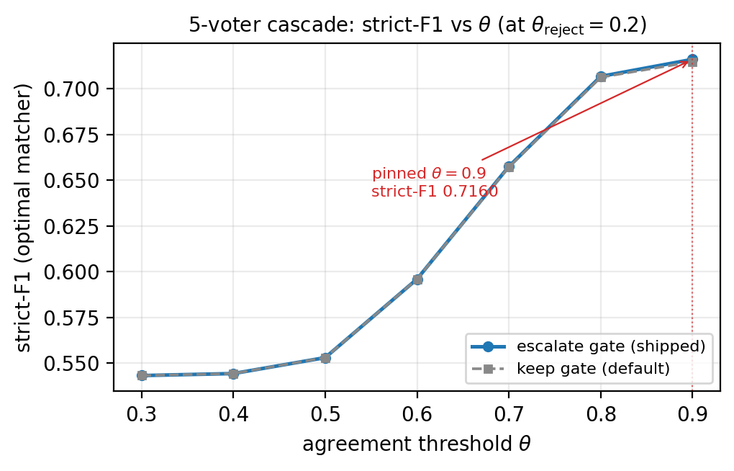
B8 · θ sweep and the gate ablation
Threshold sensitivity
• θ 0.7 → 0.8: ≈ +0.05 strict-F1
• θ 0.8 → 0.9: +0.0085 strict-F1
• optimal θ_reject = 0.2
Gate ablation
• single-voter escalate 0.7160 vs keep 0.7147: the gain is within noise
• polarity hard-fail fires on 15 of 474 chunks (3.16%)
• at θ = 0.9 it changes exactly one routing decision: 453 L3 invocations instead of 452, moving strict-F1 by 0.0001
These gates exist for safety, not for improving strict-F1.
Notes:
Use if asked whether the gates are doing anything. Answer honestly: measurably almost nothing on strict-F1, and that was never their purpose. The polarity gate is a guard against silently emitting two contradictory polarities for the same claim.

Slide 42
B9 · Cost model, operating points, and all single-model baselines
System | Strict-F1 | Cost / chunk
Cascade, five voters | 0.7160 | 23.66
Single Claude Sonnet | 0.7129 | 18.00
Single Claude Haiku | 0.6558 | 4.80
Single GPT-4.1-mini | 0.5957 | 2.00
Single Gemini Flash | 0.5761 | 2.80
Single Gemini Flash Lite | 0.5721 | 0.50
Single GPT-4o-mini | 0.5394 | 0.75
Single GPT-4.1-nano | 0.4570 | 0.50
Operating point | θ / θ_r | Strict-F1 | Cost | Escal.
economy | 0.3 / 0.0 | 0.5433 | 3.38 | 0.07
balanced | 0.7 / 0.2 | 0.6575 | 16.40 | 0.62
knee | 0.8 / 0.2 | 0.7067 | 21.80 | 0.87
quality | 0.9 / 0.2 | 0.7160 | 23.66 | 0.96
• economy = ε-constraint (lowest cost meeting a minimum strict-F1)
• balanced = ε-constraint at a higher floor (0.60), the middle the knee cannot reach
• knee = weighted-sum scalarization maximizing strict-F1 − λ·cost
• quality = maximum strict-F1
balanced → knee: +7% strict-F1 for +33% cost · knee → quality: +1% for +8.5%
Notes:
Concede the missing currency unit immediately if asked; do not improvise one. The numbers are internally consistent and comparable across systems, which is what the frontier needs, but the axis should have been labelled.
Four operating points, ascending cost. Quality is the shipped configuration - it is simply the
maximum, no coefficient and no threshold involved. Economy and balanced are the same method, the
epsilon-constraint: cheapest configuration clearing a quality floor, at 0.50 and 0.60 respectively.
The knee is the odd one out - it maximises strict-F1 minus lambda times cost.
Read the bold line rather than the table if you are short of time: a third more spend buys seven
percent, and a third again buys one. That is the diminishing-returns shape, and it is the same
point the cost-quality argument rests on.
If asked why nothing sits between economy at 3.38 and the knee at 21.80 - which is the sharpest
question this slide invites - jump to B15. Short answer: the knee is chosen by a weighted sum, and
a weighted sum can only ever return a vertex of the convex hull. Seven configurations here are
Pareto-optimal but only three are on that hull, so theta 0.4 through 0.7 are unreachable by any
lambda at all. Balanced exists because the epsilon-constraint has no such blind spot. Nothing about
the shipped configuration changes - quality depends on neither lambda nor a floor.

Slide 43
B10 · Significance testing: paper-level clustered paired bootstrap
Cascade compared with | Δ strict-F1 | 95% CI | Significant
Single Claude Sonnet | +0.0031 | [−0.0002, +0.0068] | No
Single Claude Haiku | +0.060 | > 0 | Yes
Single GPT-4.1-mini | +0.120 | > 0 | Yes
Remaining cheaper models | +0.14 to +0.26 | > 0 | Yes
• B = 10,000 resamples, papers as the sampling unit
• Clustered because findings within one paper are not independent: resampling findings would understate the variance
• Paired because both systems are evaluated on the identical chunk set
Only the Sonnet comparison is inconclusive. Every cheaper-model comparison is unambiguous.
Notes:
If pushed on 'the CI is only just crossing zero': agreed, it is marginal — the upper bound is positive and the lower bound is barely negative. But a marginal interval is not evidence of an effect, and I will not present it as one.

Slide 44
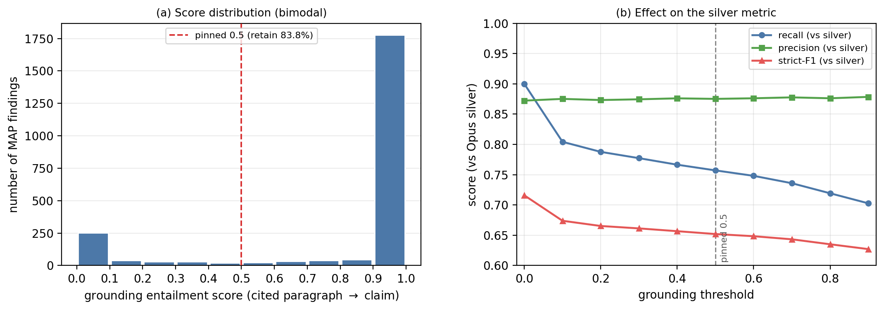
B11 · Grounding score distribution and threshold trade-off
2,294 frozen-config MAP findings on related15 · NLI run on (claim, cited paragraph)
(a) Bimodal: 77.5% of findings score ≥ 0.9, ≈ 14% score < 0.3. The 0.5 threshold (dashed) retains 83.8%.
(b) Recall and strict-F1 fall as the threshold rises; precision stays flat (0.872 → 0.875). The filter trades recall for groundedness, not for precision.
Notes:
0.5 was pinned as a design decision for source faithfulness, not chosen to maximise F1 — the F1-maximising choice is to switch the filter off entirely.

Slide 45
B12 · Relation classification, per class, both input modes
Class | predicate_only P | R | F1 | scope_aware P | R | F1
SUPPORT | 1.000 | 0.920 | 0.958 | 1.000 | 0.910 | 0.953
CONTRADICT | 0.904 | 0.940 | 0.922 | 0.896 | 0.950 | 0.922
UNRELATED | 0.885 | 0.920 | 0.902 | 0.883 | 0.910 | 0.897
Macro average | 0.930 | 0.927 | 0.927 | 0.926 | 0.923 | 0.924
Accuracy | 0.927 |  |  | 0.923
• scope_aware is the production mode. Thresholds frozen at 0.50 / 0.50, not tuned.
• A diagnostic joint sweep found the frozen thresholds are within a fraction of a percent of optimal (0.4 / 0.9 → macro-F1 0.9307)
• scope_aware's intended mechanism cannot be tested on this set: both claims in every synthetic pair share the same disease context, so they receive the same prefix
Notes:
The honest reading: predicate_only actually scores marginally higher, and the mode the pipeline ships cannot demonstrate its own mechanism on this dataset. Both facts are in the thesis.

Slide 46
B13 · Held-out knowledge-extraction funnel, side by side
Stage | related15 (calibration) | heldout15 (test)
MAP findings | 2,294 | 1,672
Grounded at threshold 0.5 | 1,923 (83.8%) | 1,379 (82.5%)
Normalized after deduplication | 1,860 (−3.3%) | 1,342 (−2.7%)
Groupable findings | 1,820 | 1,314
Canonical rules | 1,747 | 1,273
Canonical rules per normalized finding | 0.939 | 0.949
Relations, intra + cross | 25 (13 + 12) | 4 (4 + 0)
Final rules per paper | 116.5 | 84.9
Rule provenance carry-rate | 100% (1,747 / 1,747) | 100% (1,273 / 1,273)
The funnel keeps its shape. The one number that collapses is relations: the held-out papers were sampled randomly, so they share far less vocabulary and produce no cross-paper relations at all.
Notes:
This is the clearest evidence that the ILP cluster choice mattered for relations but not for strict-F1. Do not oversell the knowledge-graph angle on randomly sampled papers.

Slide 47
B14 · Provenance chain and offline replay
Provenance chain
final rule
→ canonical rule
→ normal finding
→ MAP finding
→ text element
→ document (page, span, coordinates)
Enforced by the data model: a rule cannot exist without its back-pointers.
“Provenance enables auditability, but it is not proof of correctness.”
Offline replay
• All voter outputs cached per tier per chunk, so any escalation path replays offline
• Cache invalidates on changes to the voter pool, model IDs, temperatures or MAP prompts
• One offline batch driver produces every Chapter 4 result: each analysis emits one CSV, one JSON, and a global manifest.json
• Replay fidelity validated by comparing live-cascade and replay findings per paper
Every number in this talk can be regenerated with no API calls and no cost.
Notes:
The reproducibility answer. The command is `nlp-histo replay results` and it is free — it reads cached artifacts, it does not call any provider.

Slide 48
B15 · Operating points: why the knee misses the middle
Weighted-sum reaches 3 of 7 Pareto points; an ε-constraint floor reaches all 7
ε floor ≤ | config | strict-F1 | $ / chunk | reachable by a weighted sum?
0.5433 | θ0.3 | 0.5433 | 3.38 | yes — this is economy
0.5444 | θ0.4 | 0.5444 | 3.53 | no
0.5531 | θ0.5 | 0.5531 | 4.82 | no
0.5960 | θ0.6 | 0.5960 | 9.48 | no
0.6575 | θ0.7 | 0.6575 | 16.40 | no — this is balanced, ε ≥ 0.60
0.7067 | θ0.8 | 0.7067 | 21.80 | yes — this is the knee
0.7160 | θ0.9 | 0.7160 | 23.66 | yes — this is quality, the shipped config
• knee = argmax(strict-F1 − λ·cost) with λ = 0.20. That winner holds only for λ ∈ [0.119, 0.210); above it the knee collapses onto economy
• A weighted sum returns only convex-hull vertices, so the four concave configs are unreachable at any λ. ε-constraint has no such blind spot.
The shipped configuration is the quality point: argmax strict-F1, no λ, no floor. None of this moves it.
Notes:
This is the slide for "how did you choose the operating points", and the honest answer has a
methodological wrinkle worth owning.
Quality is just argmax strict-F1 - no coefficient, no threshold. That is the shipped configuration.
Economy and the knee are reporting points that summarise the rest of the curve.
The knee uses weighted-sum scalarization: maximise strict-F1 minus lambda times cost, with lambda
at 0.20. I swept lambda afterwards. The chosen cell only holds for lambda between roughly 0.12 and
0.21, and above 0.21 the knee stops being a knee - it collapses straight onto the economy point.
But the more interesting finding is that re-tuning lambda would not have helped. A weighted sum can
only ever return a vertex of the upper convex hull of the cost-quality points. Any Pareto-optimal
point sitting in a concave stretch loses to a blend of its neighbours for every lambda. On this
curve seven cells are Pareto-optimal and only three are on the hull, so theta 0.4 through 0.7 are
unreachable by any lambda whatsoever. That is the standard limitation of the method, stated in
Boyd, which is the source I cite for it.
The practical consequence: the knee sits at ninety-two percent of the quality cost. It is not
really a middle ground. Everything between 3.38 and 21.80 was unrepresented.
The fix is not a better lambda, it is a different selection rule. Epsilon-constraint - cheapest
configuration clearing a quality floor - does not blend the objectives, so it reads the concave
region directly. I was already using it for the economy point at a 0.50 floor; balanced is the
same method at 0.60, and it selects theta 0.7: thirty-one percent cheaper than quality for about
six strict-F1 points.
If asked whether this changes any result: no. The shipped configuration is the quality point, which
depends on neither lambda nor a floor. No published number moves.
[1:15]

Slide 49
Expansion slides
Notes:
Divider. Everything after this point is written to main-slide standard and can be moved into the main line for a 30- or 45-minute slot. See PRESENTATION.md, 'Scaling the talk to the slot'.

Slide 50
E1 · The corpus graph is small, but one contradiction is real
Relation | Scope | Count
SUPPORT | intra-paper | 12
SUPPORT | cross-paper | 10
CONTRADICT | intra-paper | 1
CONTRADICT | cross-paper | 2
The intra-paper contradiction, in full
PMC2253716 — subject: MUCL1 gene · outcome: tumor grade
• “SBEM expression does NOT correlate with tumor grade”
• “Increased SBEM levels strongly associated with higher tumor grade; P = 0.0015”
NLI contradiction score 0.9991 and 0.9997 in both directions
Two statements in the same paper, pointing opposite ways. The system does not resolve it, it flags it for a human.
Honest limit: 25 edges from 1,747 rules. The comparability gate is strict by design, and on randomly sampled papers it produces almost nothing (4 edges on heldout15).
Notes:
The relation layer is the smallest part of the output and I want to present it honestly: 46 rule
nodes participate in any edge at all, 25 edges, 22 connected components, the largest with three
nodes. This is not a knowledge graph in the ambitious sense.
But look at the contradiction on the right, because it is the single best illustration of what the
system is for. Both statements come from the SAME paper. One says SBEM expression does not
correlate with tumour grade. The other says increased SBEM levels are strongly associated with
higher grade, with a p-value of 0.0015. The NLI model scores the contradiction above 0.99 in both
directions, so this is not a threshold artefact.
That is a genuine internal inconsistency in a published paper - possibly a different cohort, a
different assay, or an error - and it surfaced automatically, with both source sentences attached
and traceable to their paragraphs. The system does not adjudicate; it hands a pathologist two
sentences and says "these disagree, look".
The honest limit is at the bottom. 25 edges from 1,747 rules is sparse, and that is the
comparability gate doing its job - both claims must be polarity-bearing and share subject,
outcome, category and relation type. On the randomly sampled held-out set it produces four edges
and no cross-paper links at all. So I would not oversell this as a corpus-scale graph.
[1:15]

Slide 51
E2 · Every component is mature; the audited integration is not
Positioning against related work
• Layout-aware PDF parsing: mature (Docling, TATR, pdffigures2)
• Biomedical entity normalization: mature (UMLS, scispaCy)
• Entailment / grounding: mature (MNLI, MedNLI, biomedical NLI)
• Cost-aware cascading: mature (agreement-based cascading, Kolawole et al. 2025)
Each has its own benchmark and its own definition of success. What is rare is all of them in one auditable system, evaluated under a joint cost and quality constraint.
OCR-free end-to-end document models (Donut, mPLUG-DocOwl2) are deliberately rejected: they do not return token-level bounding boxes, so provenance could not be structural.
Also rejected: chain-of-thought self-checking and LLM self-repair, in favor of cross-provider agreement plus entailment against the source.
Notes:
If you want the one-sentence positioning: nothing in this pipeline is a new algorithm, and that is
deliberate.
Layout-aware parsing is mature. Entity normalization against UMLS is mature. Biomedical entailment
is mature. Cost-aware cascading has an established literature, and I integrate a published
framework rather than proposing one. Each of these has its own benchmark and its own definition of
success, and each is evaluated in isolation.
What is rare - and what the thesis actually contributes - is the combination: all of them in a
single system where every output is traceable, evaluated under cost AND quality at the same time.
Two rejections worth stating because they were real forks. First, OCR-free end-to-end document
models - Donut, mPLUG-DocOwl2 - can read a page image directly and skip the layout stage entirely.
I did not use them because they do not return token-level bounding boxes, and without coordinates
provenance stops being structural and becomes a claim. That would have undercut the central design
commitment.
Second, I rejected chain-of-thought self-checking and LLM self-repair loops. Both ask a model to
audit itself. I preferred cross-provider agreement plus entailment against the actual source text,
because both of those are external checks.
[1:00]

Slide 52
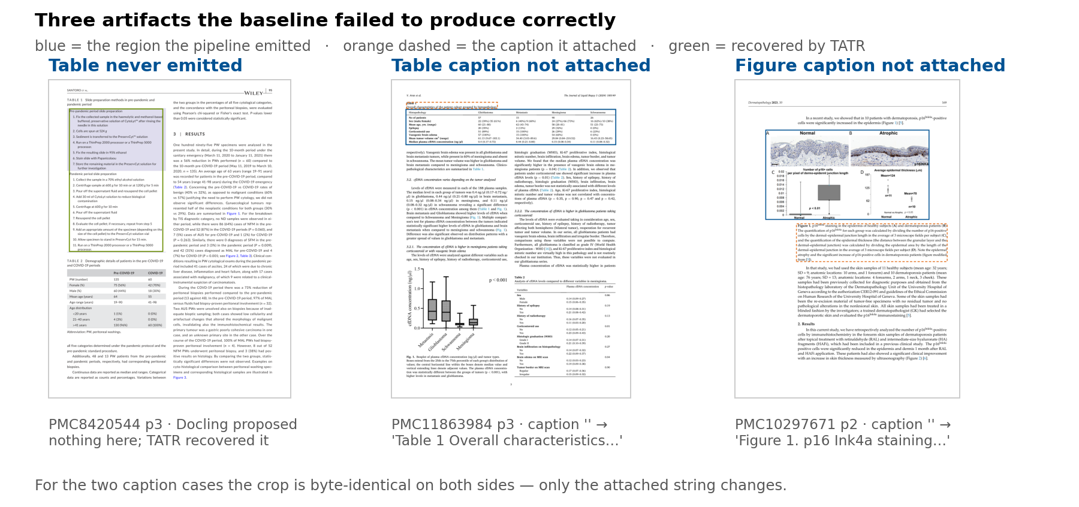
E3 · Three artifacts the baseline failed to produce correctly
One table never emitted; two captions never attached
Notes:
Three more cases, all from the rubric set, all verified against my own annotations.
On the left, a table the Docling-only configuration never emitted at all. TATR proposes it, the
union keeps it, and the rubric rates the resulting crop correct. This is the same mechanism as the
split table on slide six, on a simpler case - an ordinary single-page table that one detector
happened to miss.
The middle and right panels are caption failures. Blue marks the region the pipeline emitted;
orange dashed marks the caption it attached. You can see the spatial relationship the matcher has
to solve - caption above the table in one case, below the figure in the other. The crop itself is
byte-identical to the baseline's; only the attached string changes.
I show a table case and a figure case together because the matcher is the same code and both
failure modes are common. Eleven figures on the rubric set had no caption at all; five more had
the caption to the side; and one table had none.
The line at the bottom is the point I would make if pressed on why captions deserve a slide. A
caption is the only human-readable description of what a table or figure contains. If a rule cites
Table 2 and Table 2 has no caption, the auditor has to reconstruct from the crop what the table
was even measuring. Provenance without a caption is a coordinate, not an explanation.
[1:00]

Slide 53
E4 · The agreement scorer, end to end
One method: eligible voter outputs in, a deferral score and a winner out
• Input: the voter outputs that passed the schema and provenance gates, each a set of typed findings, not a string
• No voters → REJECT · exactly one → score 1.0 by construction (hence legacy_single_voter_policy = escalate)
• Voters with zero findings are dropped before the matrix; fewer than two survive → ESCALATE at 0.0
• Pairwise similarity over the survivors. The `hybrid` scorer blends four signals:
0.50 biomedical entity overlap 0.30 claim-embedding similarity
0.15 category agreement 0.05 cited-evidence overlap
• Each voter scores its mean similarity to the others; the chunk score is the maximum of those means
• Winner = the argmax, ties broken on grounding quality. θ = 0.9 / θ_reject = 0.2 are applied downstream, not here.
Max, not mean: one agreeing pair carries the chunk. Agreement is not correctness, which is why GROUNDING runs afterwards.
Notes:
This is the whole scoring method in one slide, and it is worth walking because every accept,
escalate and reject decision in the cascade comes out of it.
Start with what goes in. Not raw model text - the voter outputs that already survived the schema
and provenance gates, each one a set of typed findings. So "do these voters agree?" is a question
about structured records, not string overlap.
Two degenerate cases are handled before any matrix exists. Zero eligible voters is a reject. Exactly
one voter is scored 1.0 - by construction, because a single output trivially agrees with itself.
That number is an artifact, not evidence, and it is exactly why the shipped configuration sets
legacy_single_voter_policy to escalate: a lone survivor has no agreement signal, so it goes up the
cascade rather than being accepted on a synthetic score.
Voters that returned nothing are then dropped, because leaving them in would drag every real
voter's average down and manufacture disagreement. If fewer than two survive, the chunk escalates.
Only then is the matrix built, pairwise over the survivors, using the hybrid scorer whose weights
are on the slide - entity overlap dominant at 0.50, claim embedding 0.30, category 0.15, cited
evidence 0.05. Each voter takes its mean similarity to the others; the chunk's score is the maximum
of those means, and the winner is the voter that achieved it. Ties break on grounding quality.
Two things I would emphasise. First, maximum rather than mean: one tightly agreeing pair carries the
chunk even if a third voter dissents completely. That is deliberate - it is a consensus detector,
not a unanimity detector. Second, this method returns a score, not a verdict. Theta at 0.9 and
theta-reject at 0.2 are applied one layer up, which is what let me sweep those thresholds offline
without re-running a single voter.
And the caveat from the agreement-scorer slide stands: this measures agreement, not correctness. Voters can agree and all
be wrong. Nothing here detects that, which is why grounding runs against the source text afterwards.
[1:15]

